Slide 1
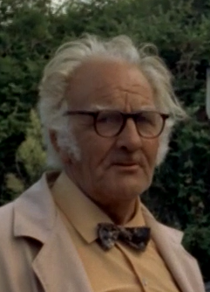
Harold Bate 1908 - 1982
Engineer, Inventor
&
Devon’s original eco-warrior
Presented by Andy Greener
on 2nd March 2022
to the West Dart History Group
©2022 WDHG
Notes:
This is a cut-down version of the presentation that was given on 2nd March 2022 to the West Dart History Group in Ashprington Village Hall. All but one of the embedded videos have been replaced by clickable links to keep the size of the presentation down, but also to respect the rights of the videos’ owners (the BBC and the Film Board of Canada). One fair-use extract of the Film Board of Canada’s film remains.

Slide 2
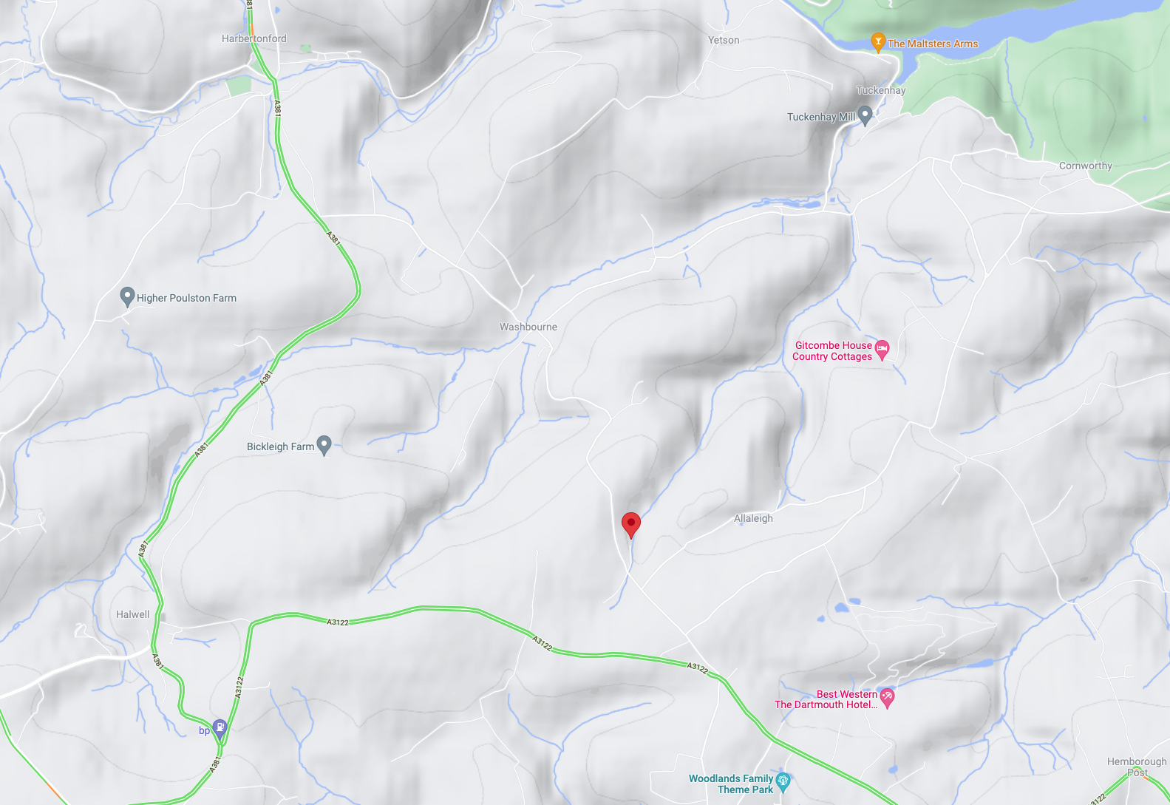
It was a wet Sunday afternoon in April 2019, I was bored…
…but we’d just had our offer on a house in Devon, called “Penny Rowden”, accepted…
…so, I thought, nothing to lose, let’s try for a…
Penny Rowden
Notes:
This seems like a diversion, but it is integral to the presentation – this and the next two slides explain how I came to discover Harold Bate and the unique connection that I have with him. This is an animated slide, which is a bit confusing if you’re not clicking through the presentation…!

Slide 3
No Googlewhack unfortunately, just under 1.5 million search results (thanks to various estate agents, Rightmove, AirBnB and a very nice-sounding lady accountant from West Sussex called Penny Rowden!) But around the bottom of page five, I came across an unlikely link to a US environmental magazine from the early 70’s…

Slide 4
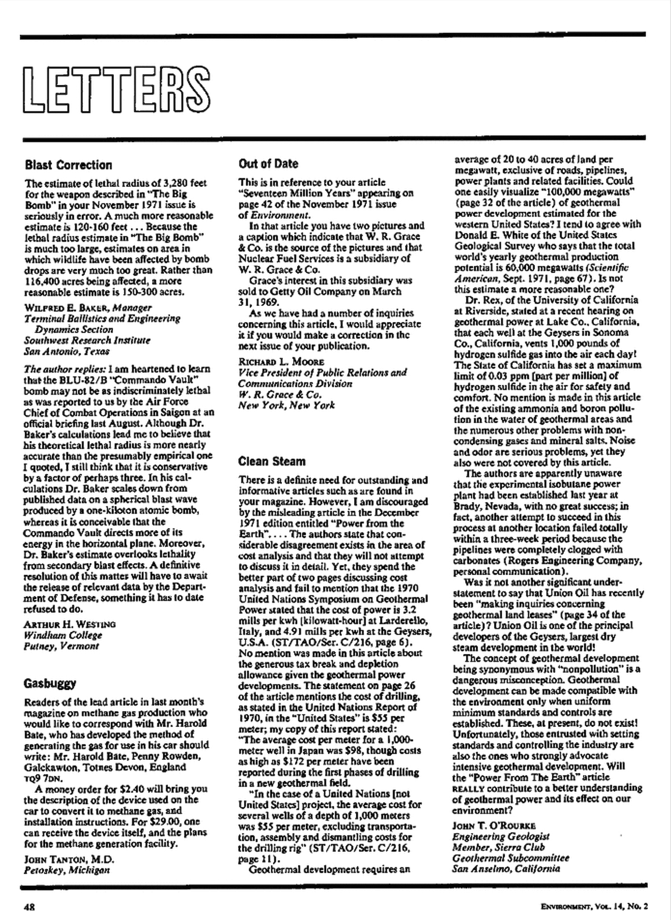
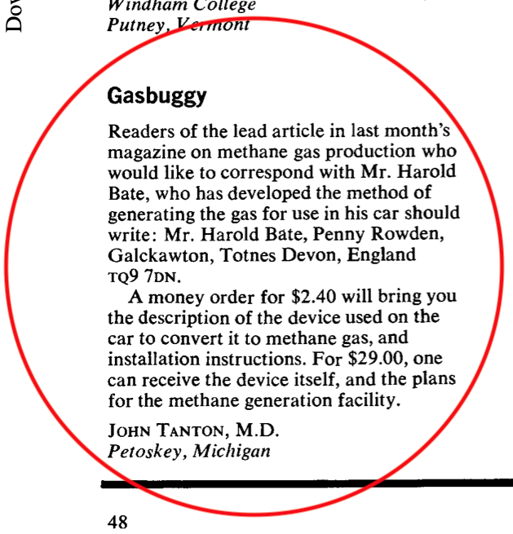
Notes:
This letter, in a 1970’s US environmental magazine, was the first inkling I had of the connection between the house I was about to buy, and Harold Bate, and I immediately turned my attention to researching him.

Slide 5
“The Chicken poo car” BBC Nationwide Originally broadcast on the 8th of September 1971 Reporter: Jack Pizzey by way of an introduction to Harold…
You can view the video used in the presentation by clicking here: Chicken poo car, 1971, BBC Archive
Notes:
I can’t do any better at introducing Harold Bate than the BBC did in this short segment from BBC Nationwide, 1971.

Slide 6
1908: Born in Stoke-on-Trent
Apprentice mechanic with the Potteries Traction company
Maintenance engineer with the Stafford Coal and Iron Company
Submarine escape devices
Advanced independent suspension systems for vehicles
1937: Lost a leg in a road accident
1947: 8-year, 380,000 mile tour of Africa with his wife (Evelyn) and daughter (Marina) in an ex-Army landrover
Prospected for gold, diamonds and uranium in Rhodesia and Tanganyika
Fought off bandits and lived off of wild game for long periods
1955: Returned to England (settling in Brixham)
Worked as an electrical contractor
Started a ferry-boat/pleasure-boat service
Drove a taxi
Started working on the convertor and methane generation
1957: Invented the Bate Auto Gas converter
1966: Bought Penny Rowden on the proceeds of converter sales
Notes:
The key chronology leading up to his purchase of Penny Rowden. The loss of a leg would have dampened anyone’s enthusiasm for life, but clearly not Harold Bate! (A taxi driver!?!)

Slide 7
To be sure, Harold Bate has invented nothing new in the way of a basic process. Methane has been forming naturally in swamps and waste organic matter since long before man walked the earth and many ingenious experimenters have harnessed this source of fuel in the past. But Harold does seem to be the first to have actually put the whole idea on a workable, homestead, “anybody can do it” basis.
Published in the USA on July 1st, 1971
Notes:
A nice summary of Harold Bate’s position in the history of renewable energy…

Slide 8
Bate’s car Sweet as a nut The national Film Board of Canada
You can view the video used in the presentation by clicking here: Bate's Car: Sweet as a Nut
Notes:
This film, which is freely available to view on the web, documents Harold Bate’s efforts with methane generation from manure and his carburettor adaptor, as well as one of his more outlandish inventions – the gravity-powered bicycle!

Slide 9
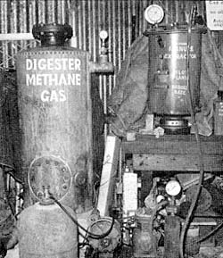
Gas production - The Bate recipe & process
75% animal droppings (half pig and half chicken)
25% straw
Stack and douse with water, leave exposed to the air for about a week
Load 300lb into an air-tight steel container, gently heat to 85˚F
Wait 4 – 7 days for gas production to start (1 day with a “starter”)
When the pressure reaches 20 p.s.i. start drawing off gas with a compressor and pump into a high-pressure 4.5 gal gas ”bottle”, filtering out small quantities of phosphoric acid and ammonia in the process. Methane liquifies at 1110 p.s.i.
This is equivalent to about 7 gallons (31 litres) of petrol
Gas production will continue for several weeks, eventually producing the equivalent of about 50 gallons (225 litres) of petrol
Notes:
This is Harold Bate’s recipe and production process for methane. He kept chickens of course, and had access to pig manure at Blackdown Farm, across the lane from Penny Rowden.

Slide 10
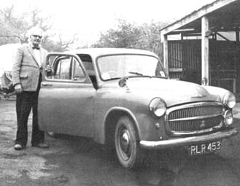
Efficacy
Caloric values per liquid pound:
Petrol 19,000 BTU
Methane 22,000 BTU
Combustion efficiency:
Petrol 27%
Methane 97%
Engines run cleaner and smoother on methane
Methane doesn’t dilute or contaminate motor oil, unlike petrol
Methane doesn’t deposit carbon on piston heads, etc
Methane exhaust gas is mostly CO₂ and water vapour, petrol exhaust contains unburnt hydrocarbons as well
Notes:
The figures speak for themselves, though the combustion efficiency claimed by Harold Bate for methane is unlikely (he perhaps means the %age of gas actually burned as opposed to being expelled). The best modern condensing gas boilers can only manage around 85-90% efficiency (in turning the chemical energy stored in the fuel into energy to do useful work or provide heat).

Slide 11
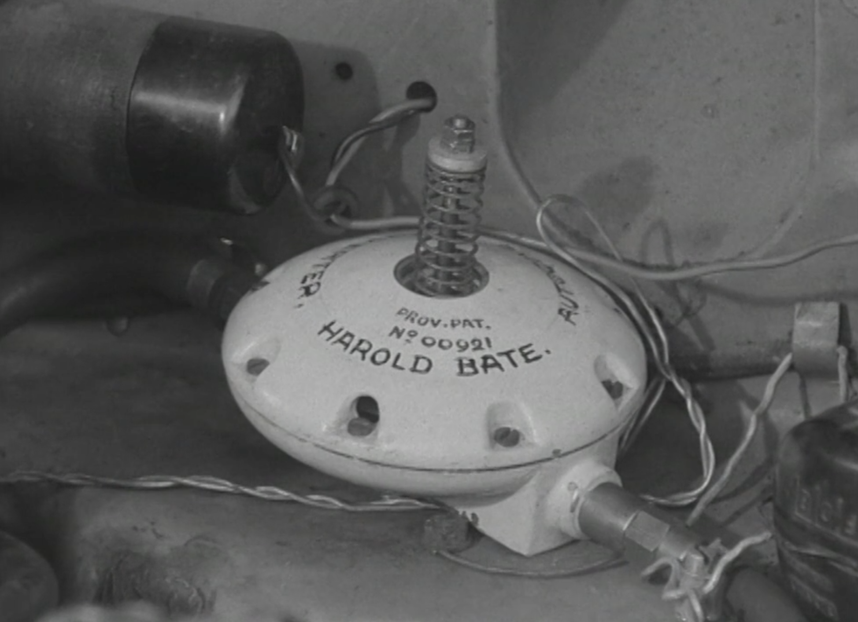
The Auto Gas Converter
Patented (No. 00921)
Approved by the Ministry of Transport
"We've looked into it," Frank Standing, information officer for the ministry said, "and the device works perfectly. However, as to mass use, that seems doubtful. There is simply not enough of a supply of chicken manure to provide fuel for cars on a mass basis.” [National Enquirer, June 1970]
AA and RAC recommended
“Thousands of cars around the world have been fitted with Bate’s device [Rolling Stone magazine, July 6, 1972]
In 1972 Harold was selling 15-20 converters a week [by his own admission]
Supplied to the Chicago and Los Angeles police departments [allegedly]
Notes:
The patent is actually a provisional patent (see writing on converter). There is no online evidence that a full patent was ever granted.

Slide 12
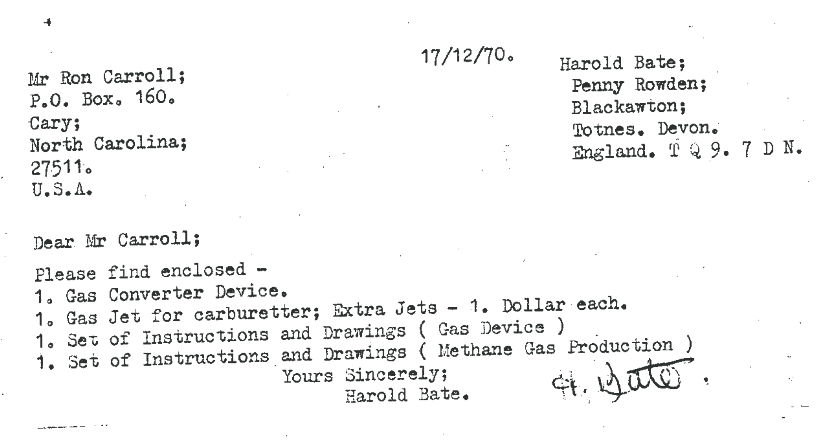
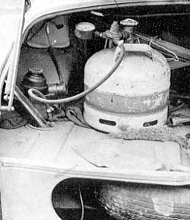
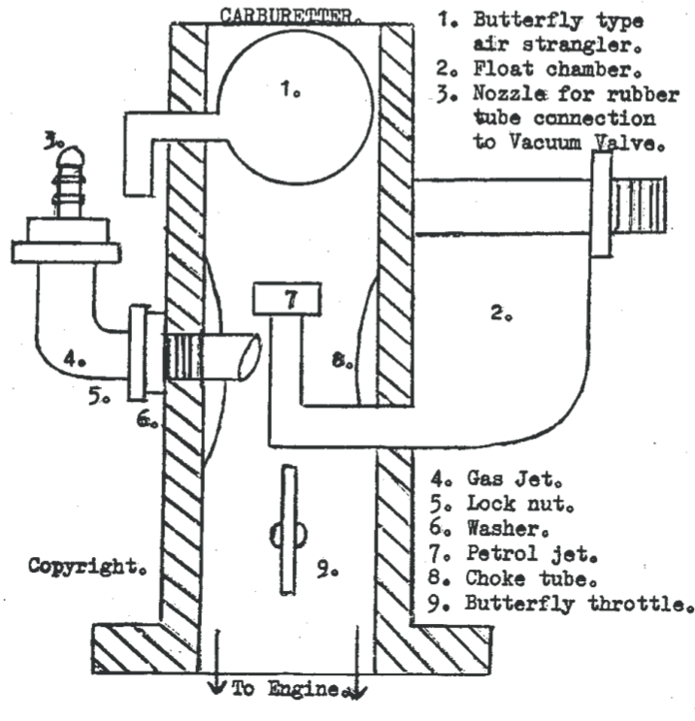
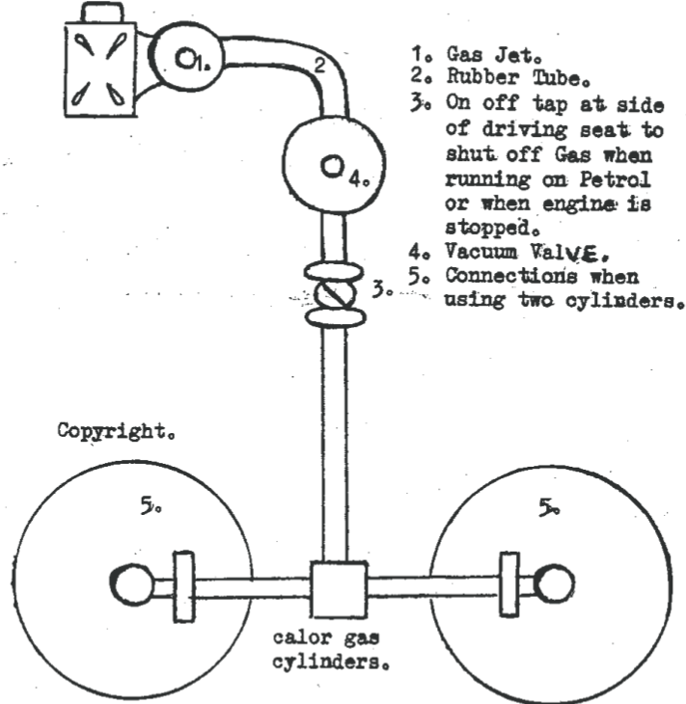
Notes:
This is a scan of an actual standard letter that Harold Bate sent to a customer in North Carolina, along with the drawings for the Gas Device mentioned in the letter (as well as the device itself). The next slide shows the instructions and drawings for Methane Gas Production.

Slide 13
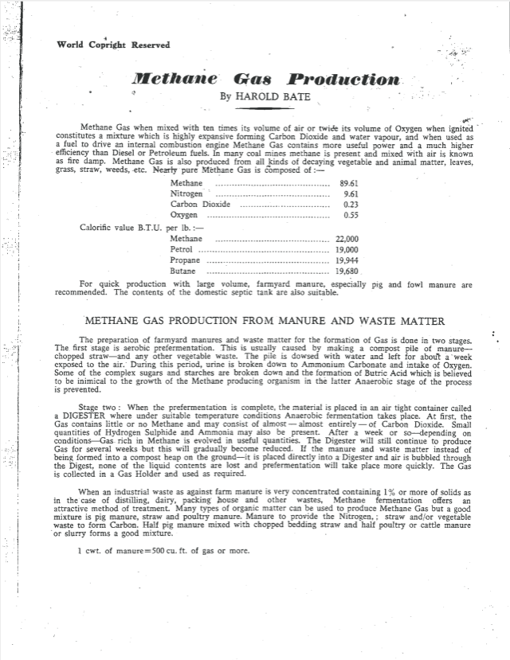
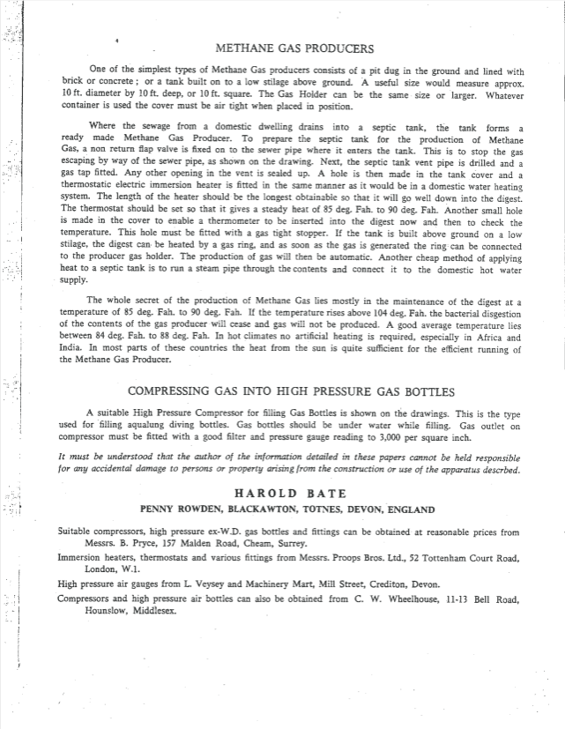
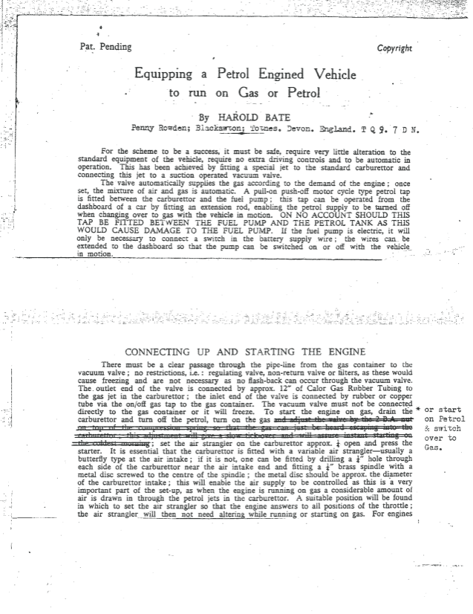
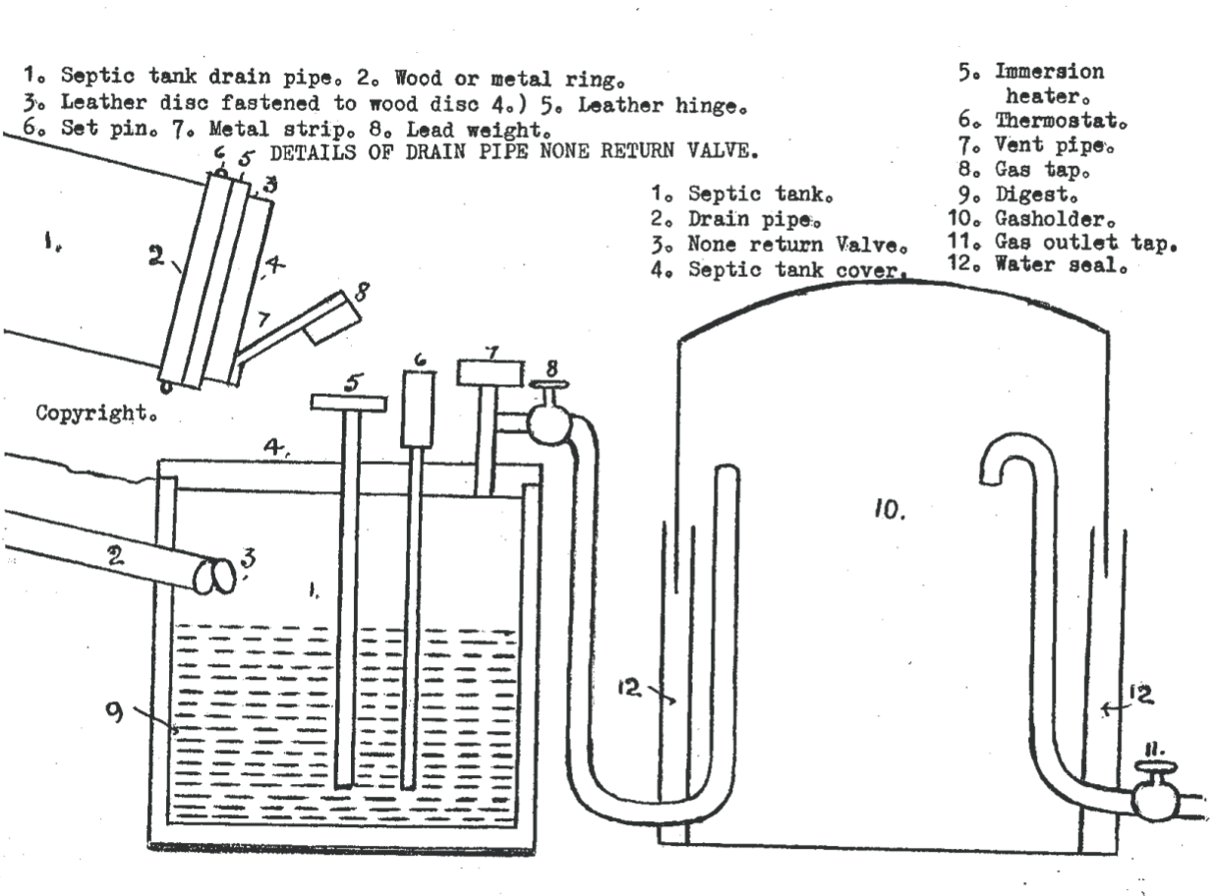
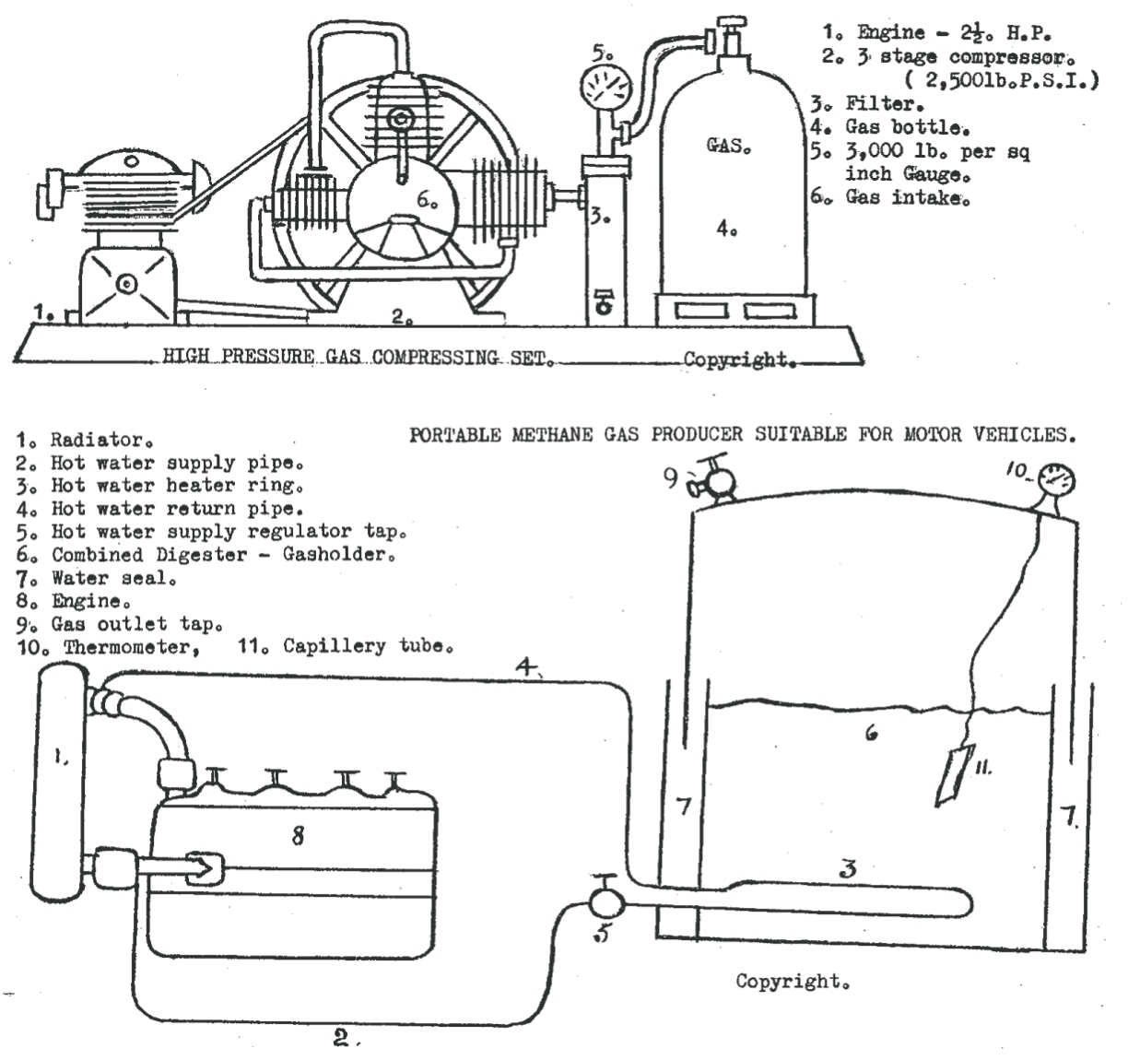
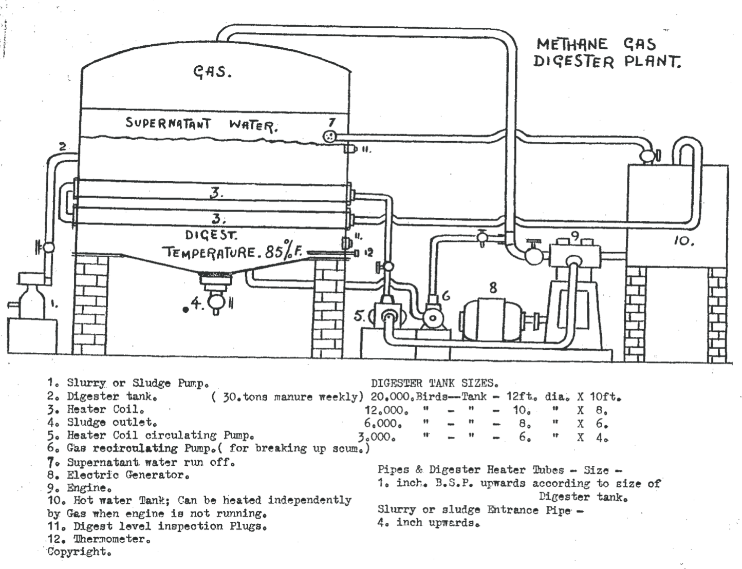
Notes:
These are Harold’s instructions and drawings for Methane Gas Production – a digester plant, an adapted septic tank, and a portable digester for vehicles (this couldn’t possibly have produced enough methane quickly enough to power any sensible vehicle!).

Slide 14
Local recollections
John Drew, farmer at Blackdown Farm since 1971 recalls:
Harold paid him £1,000 in cash in 1971 for a field adjacent to Penny Rowden, an amount large enough in those days to cause consternation at his solicitor’s office!
Harold attended a number of local shows [e.g. Stoneleigh] to demonstrate his converter, and always took a policeman friend of his along for ”protection”, allegedly from the “oil companies” who were trying to buy him out (or worse)
Blackdown Farm was the source of Harold’s pig manure and in the early seventies John estimates that they hosted 15 to 20 film crews from all over the world
The local postman was exasperated by the sacks of letters that arrived every day
Notes:
John Drew bought Blackdown Farm in 1971 and remembers Harold Bate as a neighbour and acquaintance, including the gravity-powered bicycle design seen at the end of the Film Board of Canada film.

Slide 15
Making a name for himself…
Notes:
Press interest was high in the early seventies, partly as a result of the Middle East oil crisis.

Slide 16
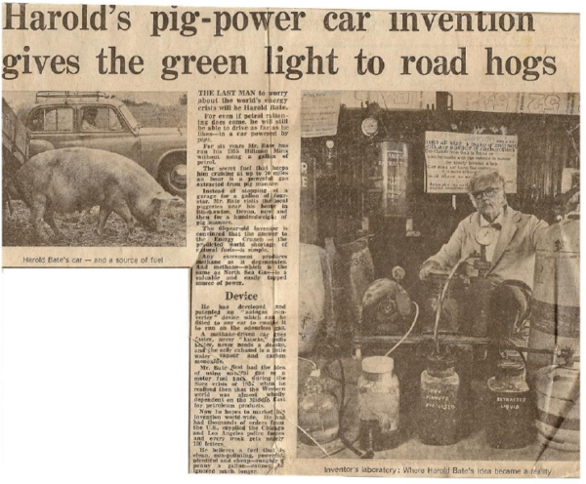
1970?, unknown publication
Notes:
This is the only known photo of Harold in his Hillman with a pig in shot! The labelled apparatus and signage in the right-hand picture are presumably what he took to local shows, etc.

Slide 17
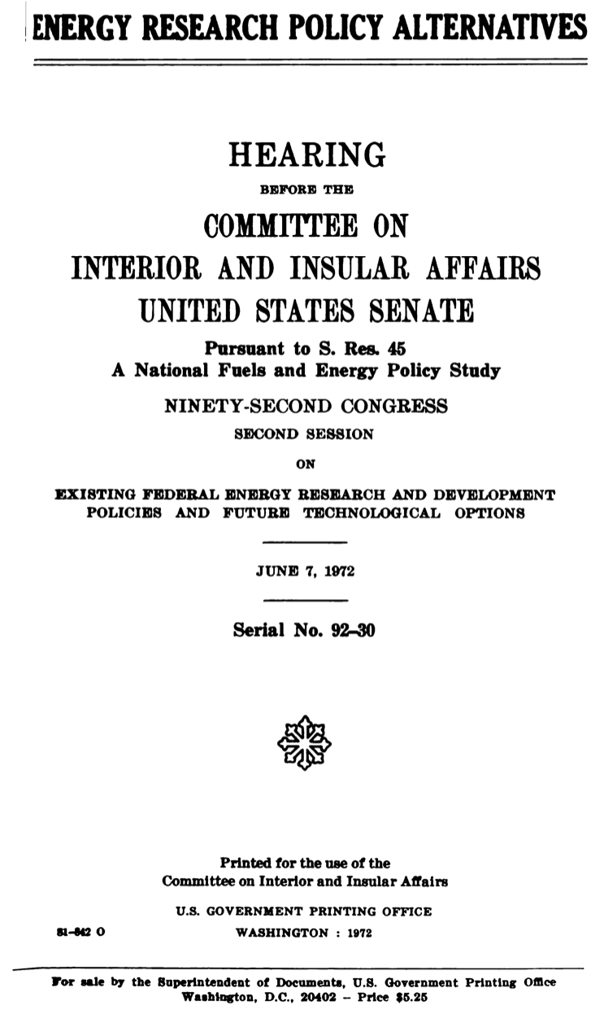
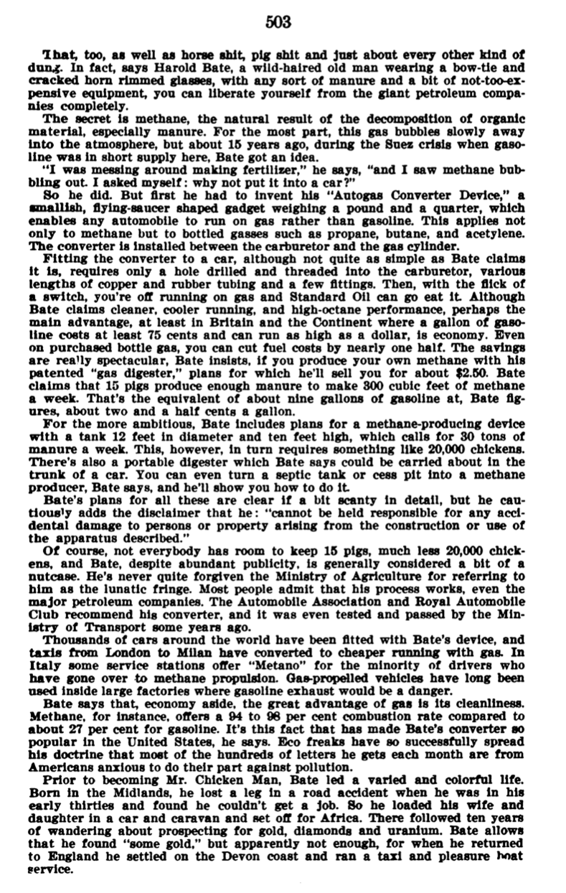
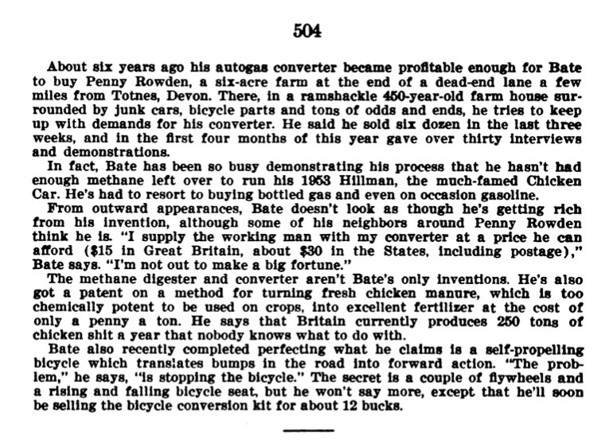
Notes:
The story about Harold Bate in the Rolling Stone magazine (reproduced in the appendix of the Hearing report, right) was provided as evidence to a US Senate hearing in support of alternative fuels! I’d like to track down the original Rolling Stone article…

Slide 18
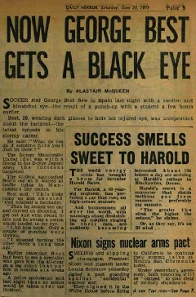
Daily Mirror
June 1973
“For Harold, a 65-year-old engineer, has perfected a car that runs on high-octane manure.”
“ “The greater the stink the higher the octane,” he claims.
Or, as they say, it’s an ill wind…”
Notes:
The Daily Mirror’s priorities in the 70’s were clearly football first!, with world affairs bring up the rear (the trivial matter of a nuclear arms deal between the US and the USSR, bottom right). Harold comes in between!

Slide 19
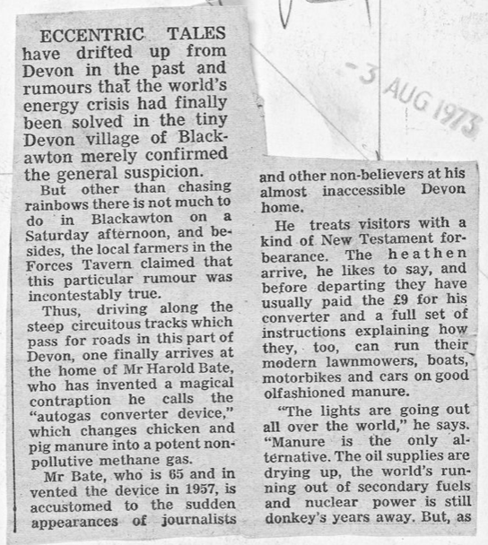
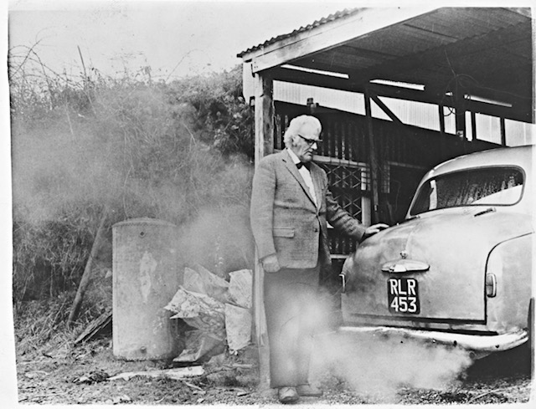
The Express & Star newspaper, 3rd August 1973
“Eccentric tales have drifted up from Devon in the past and rumours that the world’s energy crisis had finally been solved in the tiny Devon village of Blackawton merely confirmed the general suspicion.”
“… the local farmers in the Forces Tavern claimed that this particular rumour was incontestably true.”
”He treats visitors with a kind of New Testament forbearance. The heathen arrive, he likes to say, and before departing they have usually paid the £9 for his converter and a full set of instructions…”
Notes:
The Express & Star is a Midlands newspaper, so it’s unclear why they were carrying a story about a Devon inventor…

Slide 20
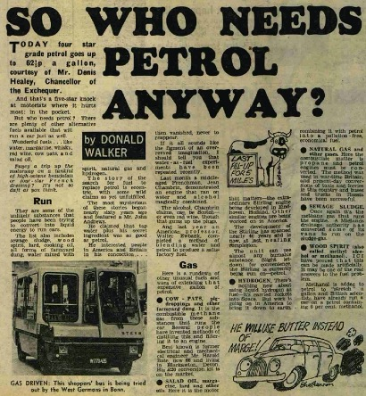
Daily Mirror
November 18th 1974
”Cow-pats, pig-droppings and other farmyard dung. It is the combustible methane gas from these substances that runs the car. Several people have invented methods of distilling this and filtering it to an engine.
Best known is former electrical and mechanical engineer Mr. Harold Bate, now 66 and living in Blackawton, Devon. His £20 conversion kit is on the market.”
Notes:
With the oil crisis in full swing, stories about alternative fuels were popular. It’s significant, I think, that Harold was the “best known” of several inventors working on methane according to a national newspaper.

Slide 21
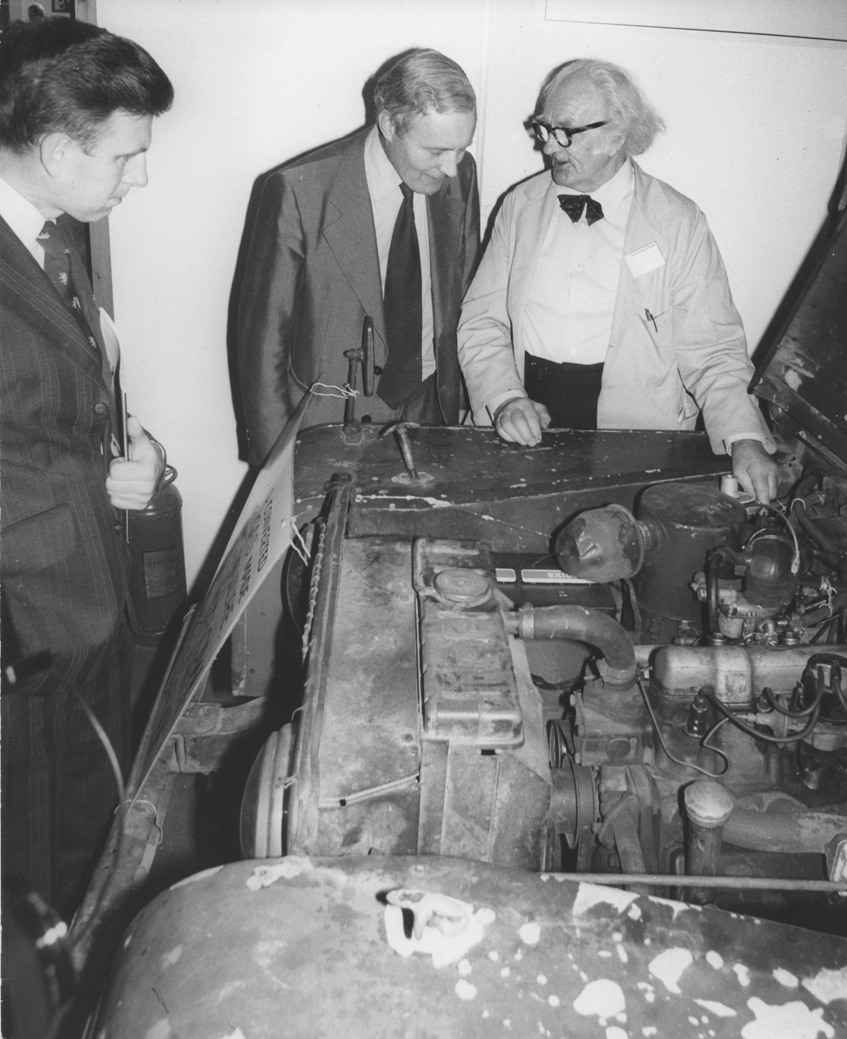
Energy Minister Wedgwood Benn Opens Energy Exhibition
At Olympia
“Inventor Harold Bate explains to Mr Benn his method of running a car at twentieth of the usual cost. His fual [sic] is literally chicken feed, by using highly toxic chicken manure to produce methane gas.”
8th September 1977
©Keystone Press Agency, Inc, NY
Notes:
This is the latest photo of Harold Bate promoting his converter. This is a press agency photo – it’s not clear whether it appeared in any publications.

Slide 22
Did it work? Was it practical?

Slide 23
Note: this a short, fair-use extract from the Film Board of Canada film: “Bate’s Car – Sweet as a Nut”
Notes:
Harold describes his plan to involve his bank manager in the handling of overseas business enquiries…

Slide 24
So that’s ok then! Harold seems to have a touching faith in south-coast provincial bank managers…
What could possibly go wrong?
Notes:
Whilst we all admire Captain Mainwaring’s patriotic desire to deal effectively with a certain foreigner, his alter ego as a provincial Bank Manager might not be quite so competent…

Slide 25
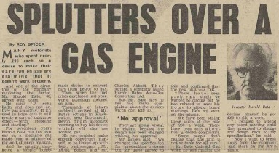
March 1974
“We have been selling these units at the rate of 200 a week.”
“He just couldn’t make enough converters himself, so he linked up with two businessmen … They formed a company called Harold Bates Auto-Gas Convertors Ltd.”
“Now I want to break away from the company and start on my own again.”
Notes:
This story indicates that all was not well in 1974 – having formed a commercial enterprise to sell converters to the general public, it seems that manufacturing design compromises may have led to problems which eventually alienated Harold.

Slide 26
Review of the Bate Autogas Convertor Device – Jerry Friedburg – May 1972
Harold Bate has made a great contribution to the world by publicizing the fact that you and I can operate our automobiles on low-emission fuel. His suggestion that we can actually produce one of those fuels – methane – from barnyard manure is also very exciting . . . but my experience leads me to believe that the famous patented Bate Autogas Convertor Device, designed to allow a standard automobile to run on methane, is not practical at all…
∆ … instructions accompanying the Bate unit state that “gas pressure from the bottle (to the convertor) should not exceed approximately 70 pounds per square inch” . . . so if you intend to compress your methane for range, you’ll need a regulator in the line between the gas tank and the Bate Convertor. As a matter of fact, because methane pressure varied noticeably with changes in outside temperature and fuel level and because the Bate Convertor is sensitive to these changes, you’ll need a regulator to stabilize the gas pressure anyway.
∆ Bate’s unit offers no automatic or other positive shut-off protection in case the convertor leaks when your automobile’s engine isn’t running. I ran a test on the Bate device I had and, sure enough, it did leak under such conditions. That’s dangerous.
∆ All in all, the Bate gadget is simply a single-stage demand regulator that must be supported by at least $150 in extra equipment if it’s to work satisfactorily (even with compressed methane).
Notes:
This review is not altogether complimentary, but I’d disagree with the conclusion that the Autogas converter was not practical. It needs some further supporting equipment by the look of it, but the idea was sound enough.

Slide 27
Gone but not forgotten…

Slide 28
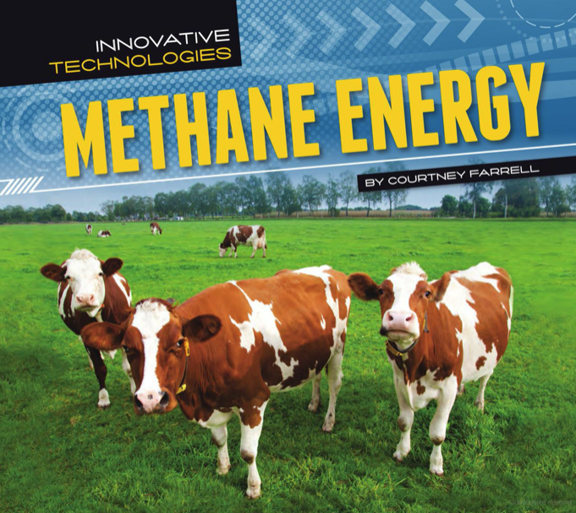
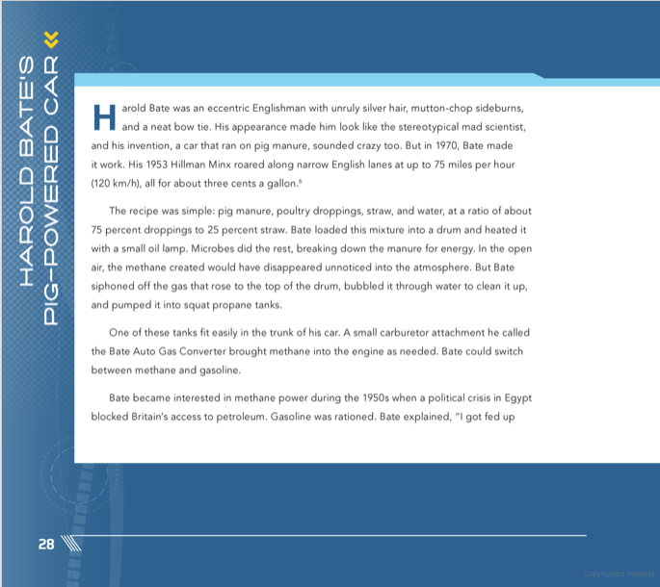
“… But the technology never caught on. In the 1970s, gas [petrol] prices were relatively low, and consumers like the convenience of gas stations. They didn’t want to load manure into their own methane digesters to make fuel.”
Published in the US in 2013
Notes:
Harold Bate is still remembered as a pioneer in methane energy circles, but the impracticality of generating your own methane is acknowledged as his nemesis.

Slide 29
In 2018, the BBC ”Ideas” website had its own take on Harold’s contribution…
You can view the video used in the presentation by clicking here: Buckle up for a drive... in the chicken poo car, BBC Ideas
Note: there is some duplication of BBC material from the Jack Pizzey interview in the first half of this video that was removed from the presentation
Notes:
The first part of this BBC Ideas video repeats some footage from the Jack Pizzey Nationwide segment (I cut it out of the presentation), but the second half makes a good case for methane as an alternative fuel and acknowledges Harold Bate’s part in it.

Slide 30
The Potential Benefits of Biogas*
* Methane generated from bio-waste

Slide 31
“Sir, The debate over the use of hydrogen as a future carbon-neutral fuel is a distraction. We do not need hydrogen to meet carbon-zero targets, as there are more readily available alternatives.
The world dumps about 100 billion tonnes of biogenic waste into the environment every year, including food waste, sewage, animal slurries and agricultural residues, which ferment and produce methane. Were we to capture those wastes and their methane, we could produce renewable, carbon-negative energy known as biogas, as well as composts to return humus to our badly depleted soils.
The World Biogas Association (of which I am a former president) and the International Energy Agency estimate that capturing approximately half of this waste would cut greenhouse gas emissions by 10 per cent, and generate energy equivalent to 32 per cent of the natural gas used worldwide.
The technologies to do this exist. The problem is that collecting and treating these wastes is more expensive than dumping them, a quandary that can be solved only by legislative means. Governments would do well to look at their biowastes and get them into treatment urgently. In doing so they would reduce emissions and produce energy and compost — using technology that is available now and at a cost far lower than that of producing hydrogen.”
David Newman Managing director, European Circular Bioeconomy Policy Initiative
(Letter to The Times, August 18, 2021)
Notes:
The highlighted sections are the key points of this letter to The Times – 100 billion tonnes is an awful lot of waste (all of which is a source of atmospheric methane – a powerful greenhouse gas). Mr Newman makes the point that the technology exists but that only Government can make it work on the scale required to make a difference.

Slide 32
The 2022 Perspective
In the 1970s, the emphasis of environmental concerns was on pollution, not climate change – sustainability was not a “thing”
However, biogas (as we call it now) is a sustainable energy source
Harold recognised that fossil fuels were a finite resource that would one day run out, but he was also motivated by reducing cost
Unfortunately US consumers weren’t (for the most part)
And the UK Govt wasn’t really interested
Shifting from fossil fuels to renewable fuels would have needed massive infrastructure investment and the (international) political will to do so
But if we had, perhaps climate change would have been more contained
Notes:
Before climate change we were mainly worried about the pollutants released into the atmosphere from burning “dirty” fossil fuels such as oil and coal, and their effect on human health as well as the health of the global ecosystem. Sustainability is the modern term, but Harold Bate fundamentally understood that our energy needed to be renewable, and that we couldn’t rely on fossil fuels for ever. However, he didn’t just voice it, he set about demonstrating it.
But as ever we were reliant on politicians to do the right thing, but that seldom concurs with their own priorities.

Slide 33
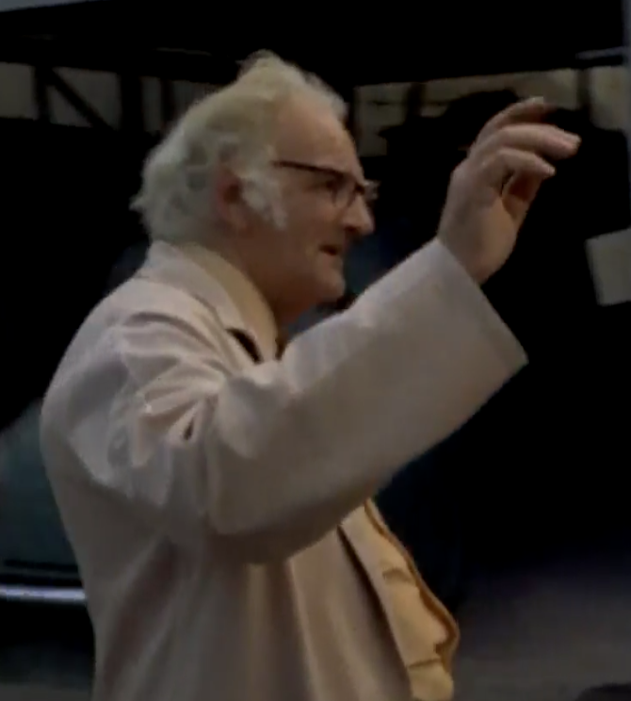
What of our hero?
Ahead of his time?
Quite possibly
A Visionary?
Not consciously, but maybe so in hindsight
A Dreamer?
Maybe, but for the most noble of reasons
A Revolutionary?
He could’ve been, had it caught on, or been promoted more effectively, or been adopted by Government
An Inspiration?
Seemingly, but you can be the judge of that
Notes:
My vote is for ‘inspirational’, but maybe I’m biased…

Slide 34
Thank you for your attention! Any Questions?
?
andy@pennyrowden.uk

Slide 35
A Challenge to the Group!
All the material in this presentation was obtained from online sources, one way or another, except for John Drew’s personal recollections.
There’s probably a lot more information about Harold Bate and his life out there in more traditional (offline) sources.
Would a real historian like to step up to the plate and add to our knowledge?
Notes:
I’m not a historian, I’m a software engineer. A “proper” historian will know where to look for more information to backfill this story, including what happened to Harold in later life and what became of his demonstration equipment, converters, etc.

Slide 36
Selection of comments from the BBC Archive, Sept 2021, #OnThisDay 8th Sept 1971
“The petrol companies will have made sure this idea was buried at the time. Too harmful for their profits, like lots of ideas over the years.”
“He was probably bought out by the oil companies and told to go away you silly man. Because pure greed of the oil companies had taken over by then plus governments couldn't work out a way to tax it”
“I fail to see why people are so surprised by the idea of running vehicles on methane(natural gas). Pumping engines in sewage treatment plants have been run off the methane produced from the sewage for at least 60 to 70 years that I know of.”
“Biogas is pretty normal. Used often, where appropriate.”
“1.1 billion chickens were slaughtered for meat in the UK in 2017. That's an awful lot of manure to recycle and repurpose.”
“He sold conversions to run off compressed Town gas - it was illegal so the chicken poo was a cover story”
“The British eccentric exists for the benefit of mankind”
“Wonder did he suddenly die not long after that was broadcast…”
“Fantastic. If only we had more people like this nowadays. I wonder if his house still stands?” [Oh yes ☺]
“Why we not using this stuff now instead of going all electric”
“Proper British boffin. Mad as a French goose in a pâté factory.”
“Mr Bate and his cars powered by 'chicken by-products' were regular attendees at the Royal Show at Stoneleigh in the 1960s . Saw both the Hillman Minx in the Nationwide piece and its predecessor, a wartime Humber FWD, similar to the vehicles the BBC used during WWII for War Reporting!! There were some vehicles operating on methane gas in the 1960s ,but mainly used off the road.”
“He was always on Southwest news when I lived in Devon.”
“Exploitation of chickens...we take their eggs and nuggets already....”
“Was expecting to see the flux capacitor at some point. Liked his idea though.”
“The "Doc" got left in 1971 and is still trying to get back”
Notes:
When the BBC reproduced Jack Pizzey’s Nationwide interview for “On This Day” (a look back at what the BBC were reporting 50 years ago that day) in September 2021 they got more than 500 comments. These are a selection of the more interesting, controversial, articulate and amusing ones. More than a few commenters made the link with “Doc” Brown from Back to the Future! I think it’s the hair, and the eccentricity of course ☺

