Slide 1
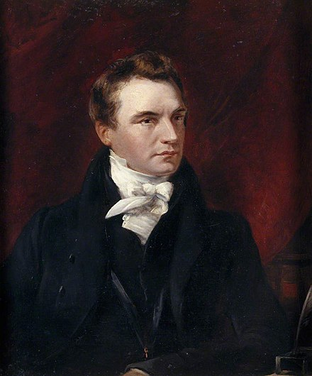
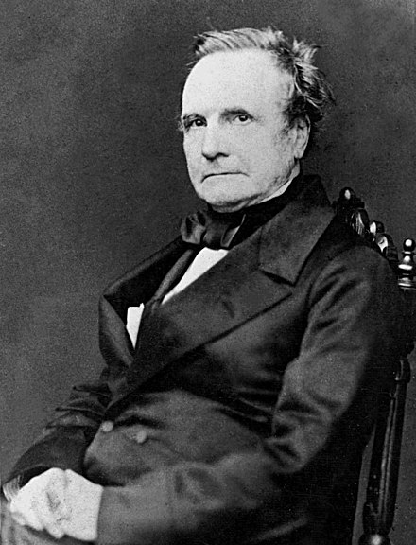
Charles Babbage – Totnes’s Computer Pioneer?
Andy Greener, B.Sc, C.Eng, CITP, MBCS
May 2023
1820
1860

Slide 2
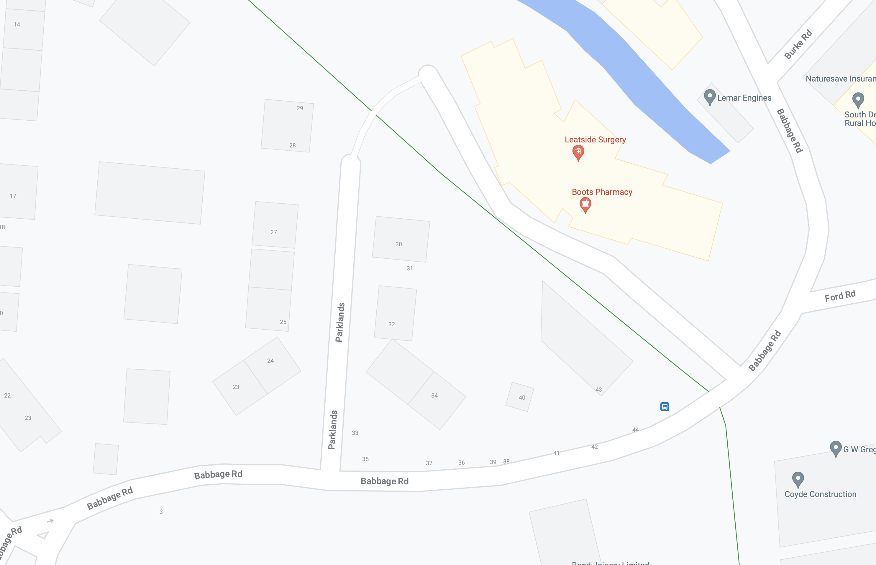
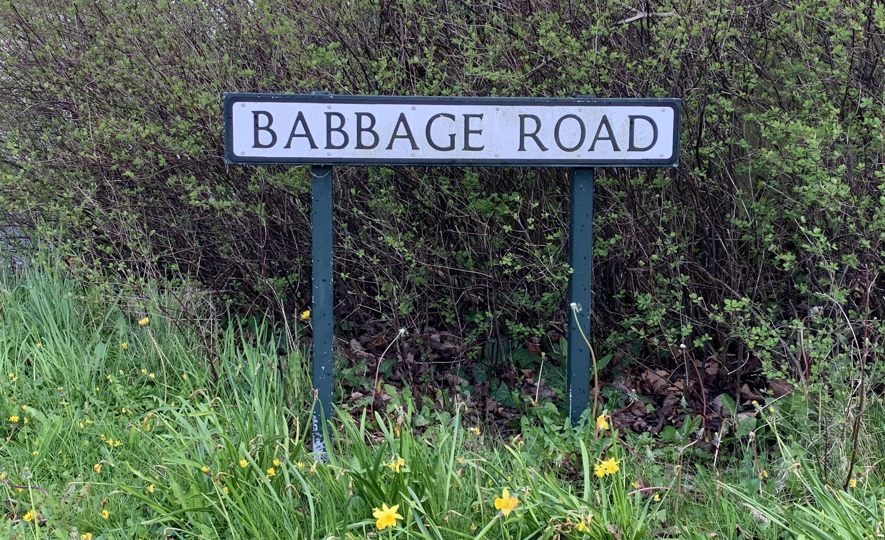
Notes:
Main road forming the post-war industrial estate

Slide 3
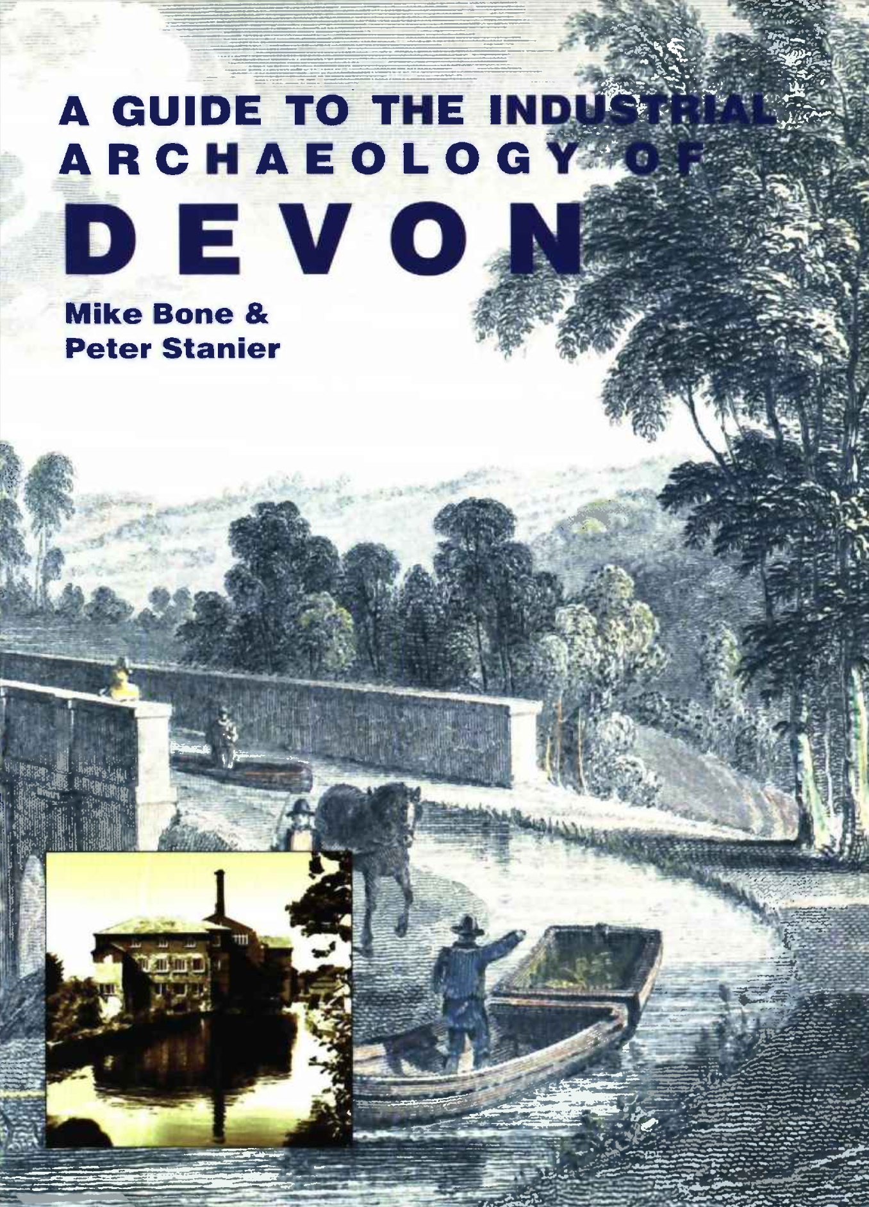
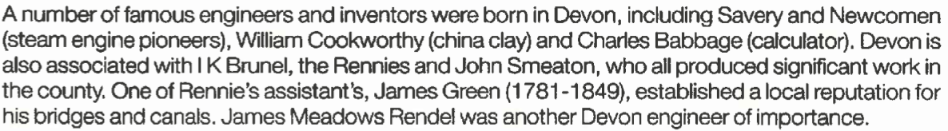
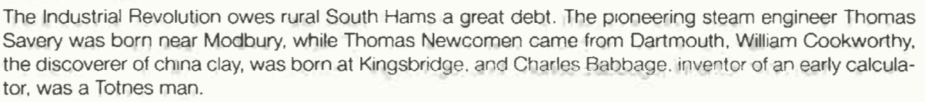
Published by the Association of Industrial Archeology 1998
Historical Introduction:
South Hams:

Slide 4

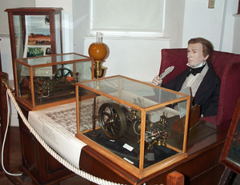
Claims Babbage as an alumnus of Totnes Grammar School and from a “long-standing Totnes family”, but is careful to avoid mentioning his place of birth.
The Babbage Room, dedicated to the life and work of the mathematician and inventor

Slide 5
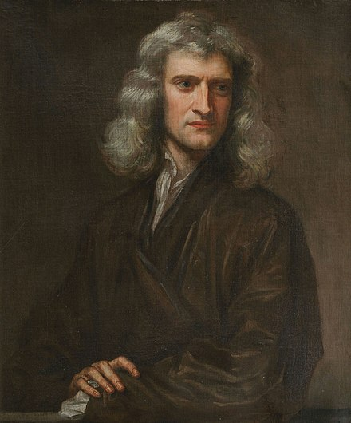
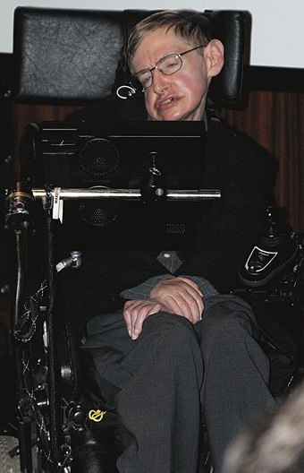
Charles’s Personal Timeline
1791 Born in Walworth Road, London on 26th December – as evidenced by an entry in the baptismal register at St Mary Newington on 6th January 1792 – the only son of a wealthy London banker
1801 Briefly attended Alphington school near Exeter, for health reasons
1808 Family moved to East Teignmouth – briefly attended King Edward VI Grammar School, Totnes (then adjacent to the Guildhall) whilst staying at Birdwood House in the High Street
1811 Entered Trinity College, Cambridge
1812 Formed the Analytical Society
1814 Married Georgianna Whitmore
1816 Elected a Fellow of the Royal Society
1820 Helped found the Royal Astronomical Society
1828 Became Lucasian Professor of Mathematics at Cambridge
1832 Stood for Parliament (failed)
1834 Stood for Parliament again (failed)
1871 Died on 18th October, in London, persecuted by street musicians and neighbours!
Notes:
1830s views included disestablishing the Church of England
Stood for Finsbury, third of five, and last of four
Lucasian chair – held by Isaac Newton, and until 2009, Stephen Hawking

Slide 6
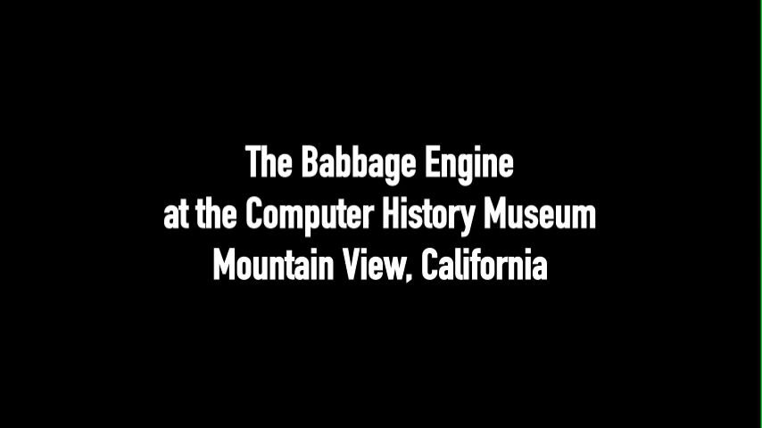

Slide 7
That is what Babbage envisaged when he designed (but never finished in his lifetime) the Difference Engine, a machine capable of compiling mathematical tables without human intervention…
… but what are mathematical tables, and what are they for?

Slide 8
Mathematical tables
In the 18th and 19th centuries tables of Logarithms and trigonometric functions were central to
  Mathematics
  Navigation
  Science
  Engineering
  Surveying
  Astronomy
As the industrial revolution got into full swing, and Britannia ruled the waves, Britain needed to be at the technological cutting edge to stay ahead (mainly of the French ☺)
But why, exactly, were these tables so important?

Slide 9
69.31 x 57.43
69.31 x 57.43 = ?
With thanks to mammothmemory.net for the example and illustrations

Slide 10
69.31 x 57.43
6931
x 5743
69.31
x 57.43
(moved 2 decimal places)
(moved 2 decimal places)
34655000
4851700
277240
20793
4
1
6
2
3
1
2
39804733
3980.4733
(replace 4 decimal places)
1
2
1
1
1
69.31 x 57.43 = 3980.4733

Slide 11
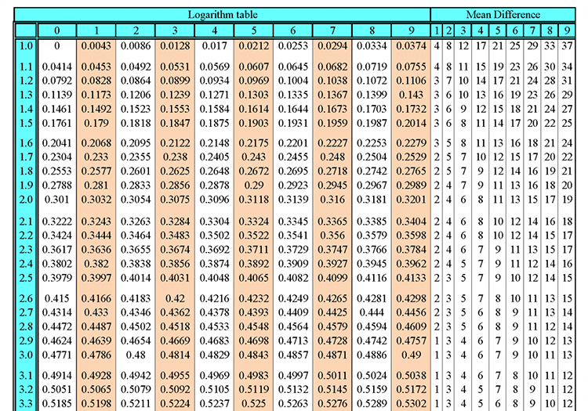
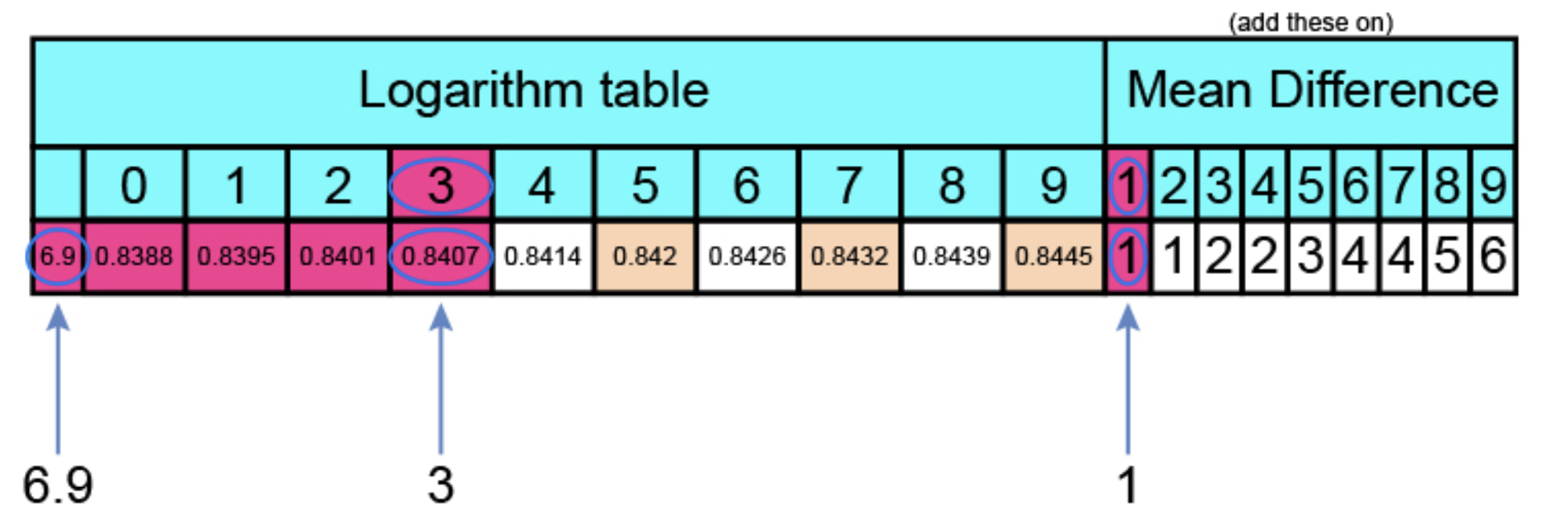
Tables of logarithms make it easy…
100 x 100 = 10,000 or (10 x 10) x (10 x 10) = (10 x 10 x 10 x 10) or 10² x 10² = 10⁴
You just add the exponents!!
We can use the log table to translate 69.31 into a (fractional) exponent:
But logs only work for values between 1 and 10
So, factor 69.31 into 10¹ x 6.931 and look up 6.931 in the table
0.8407 + 1 (to the last digit) = 0.8408
So 69.31 = 10¹ x 10^{0.8408}
69.31 = 10^{1.8408}
69.31 x 57.43 = 3980.4733

Slide 12
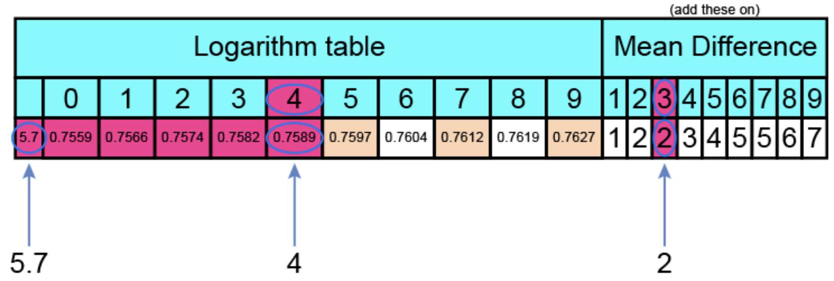
Tables of logarithms make it easy…
In the same way we can use the log table to translate 57.43 into a (fractional) exponent:
But logs only work for values between 1 and 10
So, factor 57.43 into 10¹ x 5.743 and look up 5.743 in the table
3
0.7589 + 2 (to the last digit) = 0.7591
So 57.43 = 10¹ x 10^{0.7591}
57.43 = 10^{1.7591}
69.31 x 57.43 = 3980.4733

Slide 13
Tables of logarithms make it easy…
So, 69.31 x 57.43 is the the same as 10^{1.8408} x 10^{1.7591}
To get the answer just add the exponents…
1.8408
+ 1.7591
3.5999
The answer, therefore, is 10^{3.5999} which is 10³ x 10^{0.5999}
But what do we do with this new exponent, 0.5999?
69.31 x 57.43 = 3980.4733

Slide 14
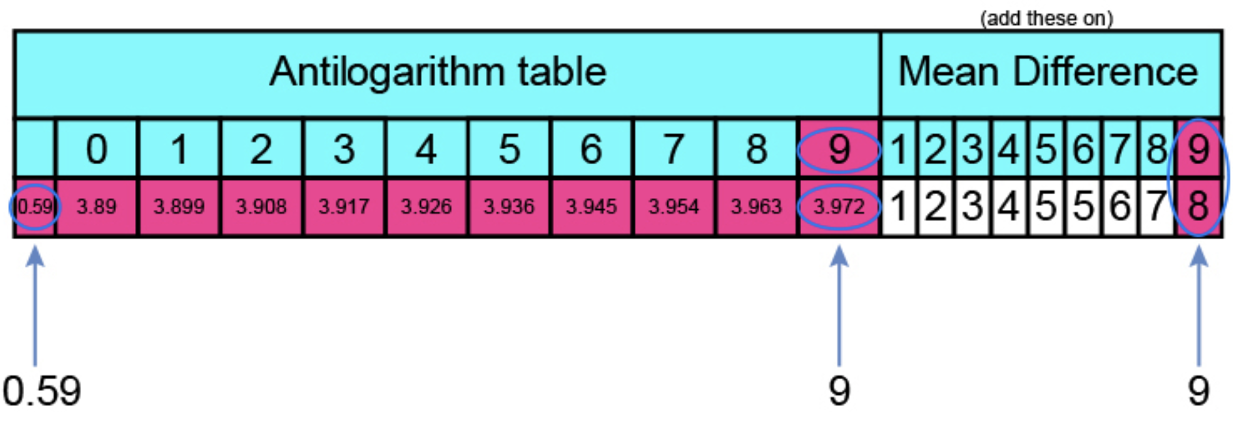
Look it up in an antilogarithm table…
(or use a Logarithm table in reverse)
0.5999
Which gives us 3.972 + 8 (to the last digit) = 3.980
Multiply by 1000 (10³) to get 3,980
69.31 x 57.43 = 3980.4733

Slide 15
…and guess what? For division you do exactly the same kind of lookups,
but you SUBTRACT the exponents instead of adding them.
Imagine using the same values to do long division?
69.31 / 57.43 = ?

Slide 16
Charles’s Motivation
As early as 1812 he was aware that tables of logarithms were full of mistakes
An idea occurred to him: industrial mass production techniques could be applied to the production of mathematical tables
The French government had already done it by breaking down the operation into simple stages, restricted to addition and subtraction, performed by 80 (human) computers – but humans are fallible
He took this idea to its logical conclusion at the height of the industrial revolution: mechanise the process!
However, it was 1819 before he began working on the idea
Whilst examining two sets of supposedly identical astronomical tables he noticed a series of errors, and exclaimed:
I wish to God these calculations had been executed by steam!

Slide 17
Charles’s Motivation
Babbage started to design a vast calculating engine, far more powerful and ambitious than anything that had been attempted before.
It would be capable of calculating successive values of mathematical series using repeated addition, thanks to a cunning mathematical technique called the Method of Differences.
These series can be represented by equations called Polynomials
  E.g.: F(x) = 2x² - 3x + 2 (repeatedly solve for successive values of x)
Babbage named his design the Difference Engine.
… but what is the “Method of Differences”?

Slide 18
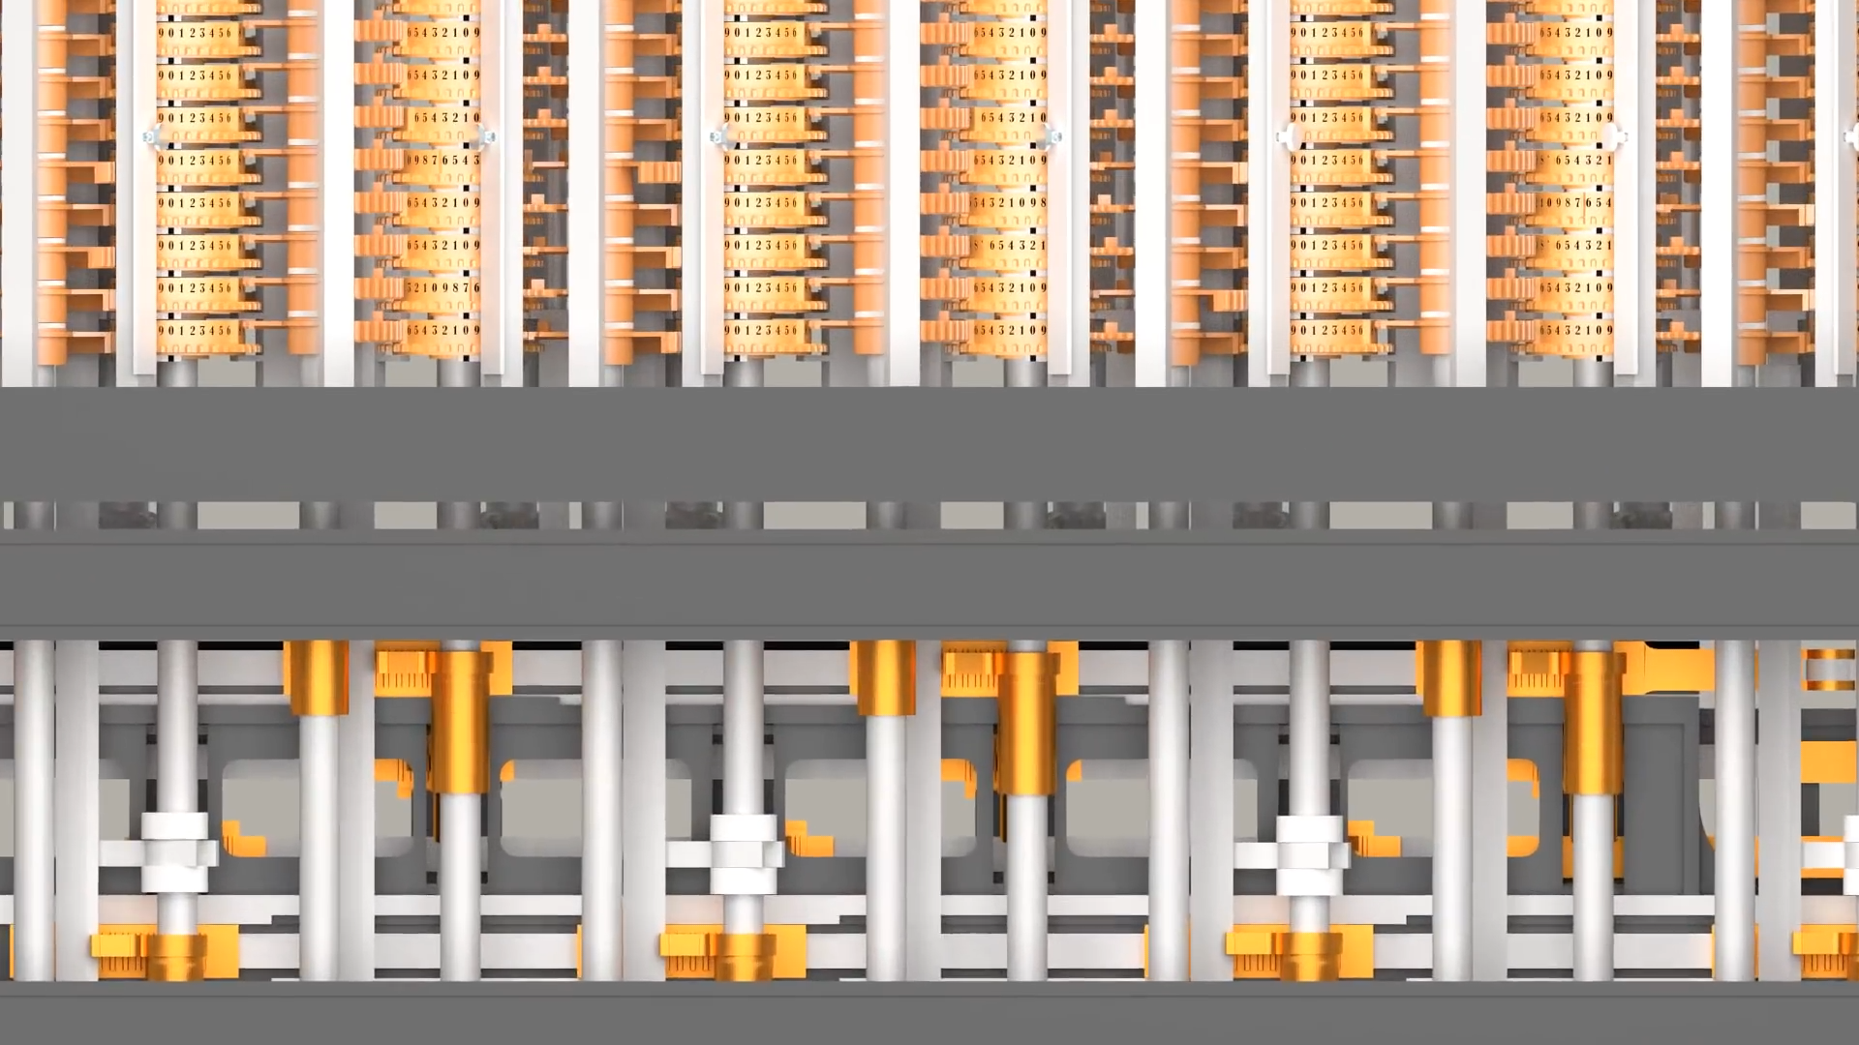
The Method of Differences (a.k.a Newton’s method of divided differences)

Slide 19
Chronology of his (mathematical) inventions
1822 Difference Engine 0 – the prototype demonstrator
- Unfinished, but would have comprised 25,000 parts (15 tons, 8ft tall)
1821 Work started on Difference Engine No. 1
  - 20-digit numbers, sixth-order differences (i.e. 7 columns)
1823 Received £17,000 funding (=2 battleships) from the British Government (actually the Admiralty), teamed up with mechanical engineer Joseph Clement
1831 Fell out with Joseph Clement over costs
1832 One-seventh demonstrator of Difference Engine No. 1 (still working today!)
  - 6 digit numbers, second-order differences (i.e. 3 columns)
1833 Work suspended on Difference Engine No 1
1834 – 1840 Design for the Analytical Engine
- Never built
1847 – 1849 Design for Difference Engine No. 2
- Never built in his lifetime (but completed in 1991 at the Science Museum)

Slide 20
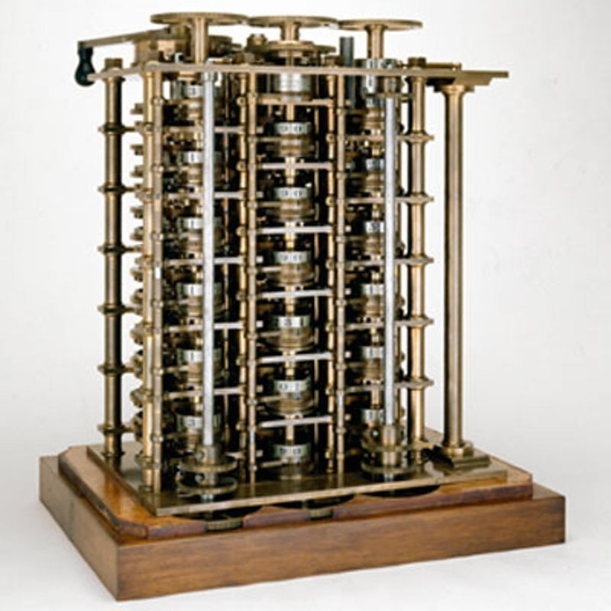
The surviving demonstrator of Difference Engine No 1
Six digit numbers, 2nd order differences

Slide 21
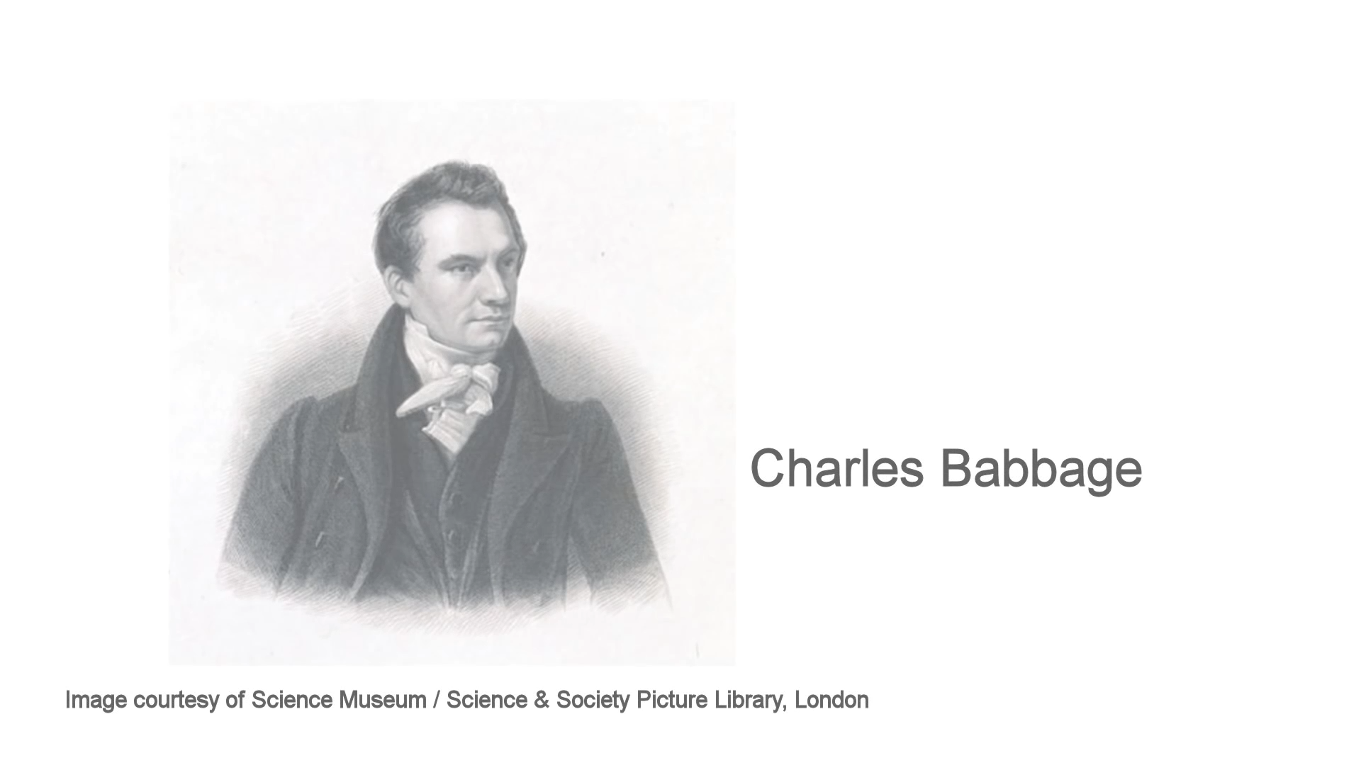

Slide 22
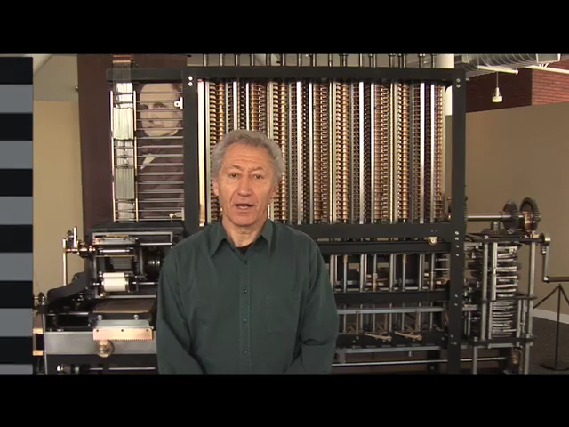

Slide 23
But of course Charles wanted to use steam!

Slide 24
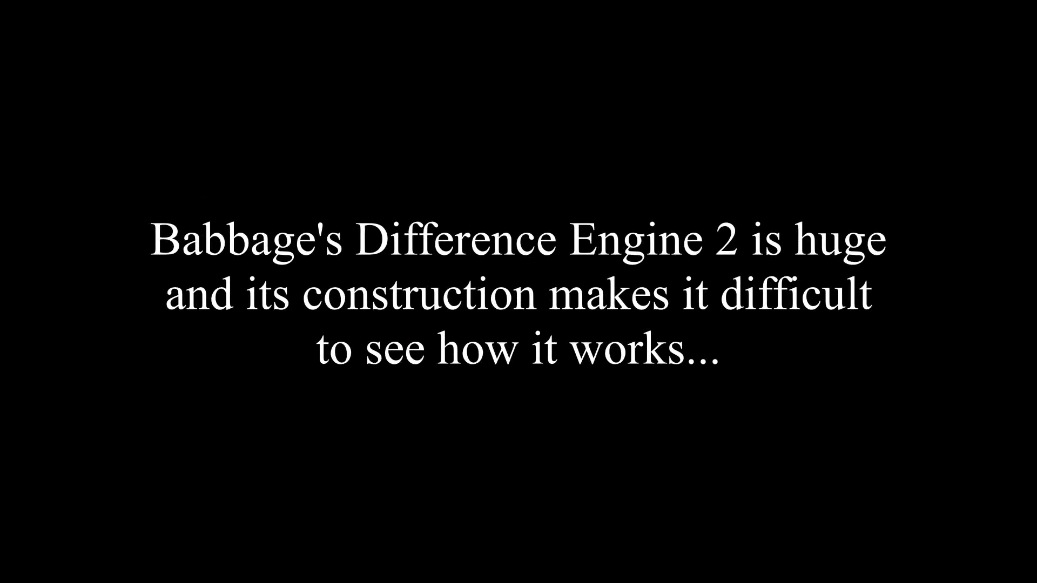

Slide 25
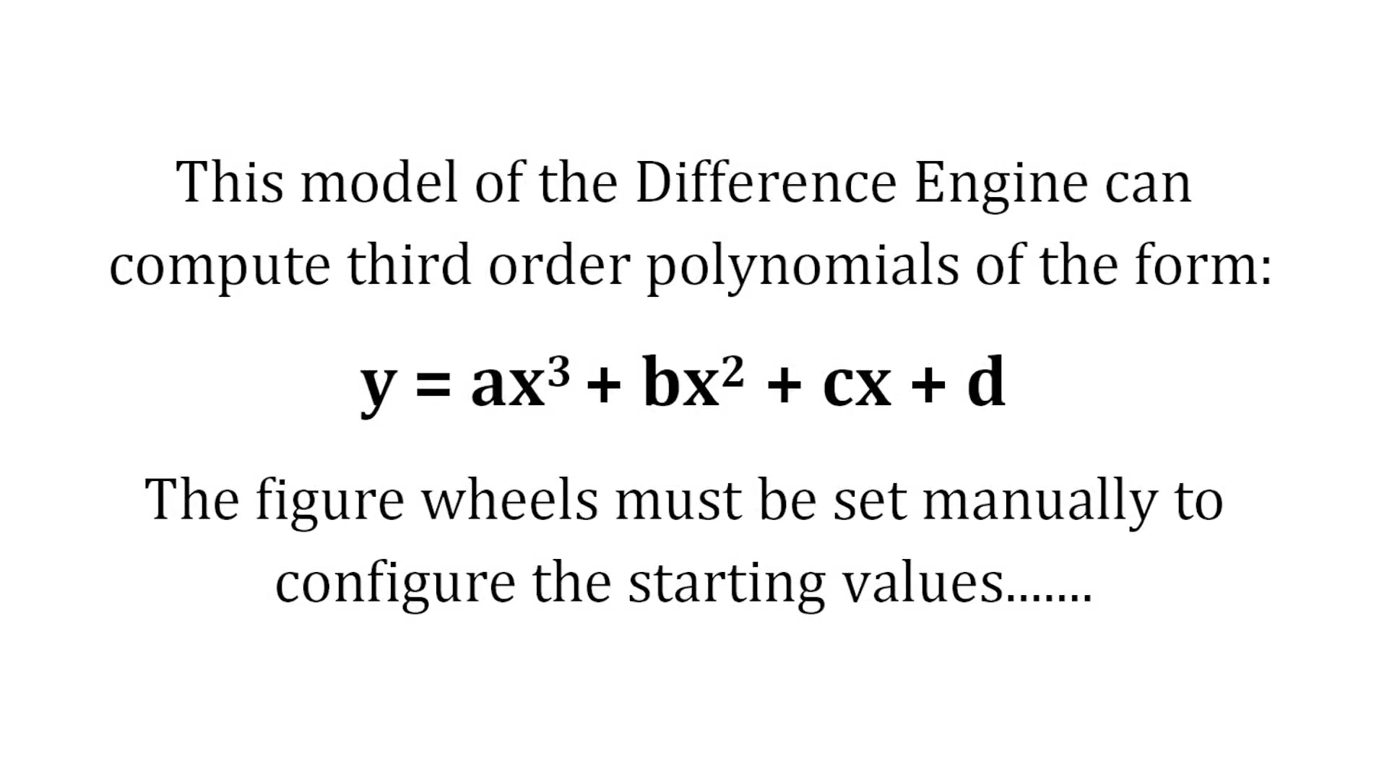

Slide 26
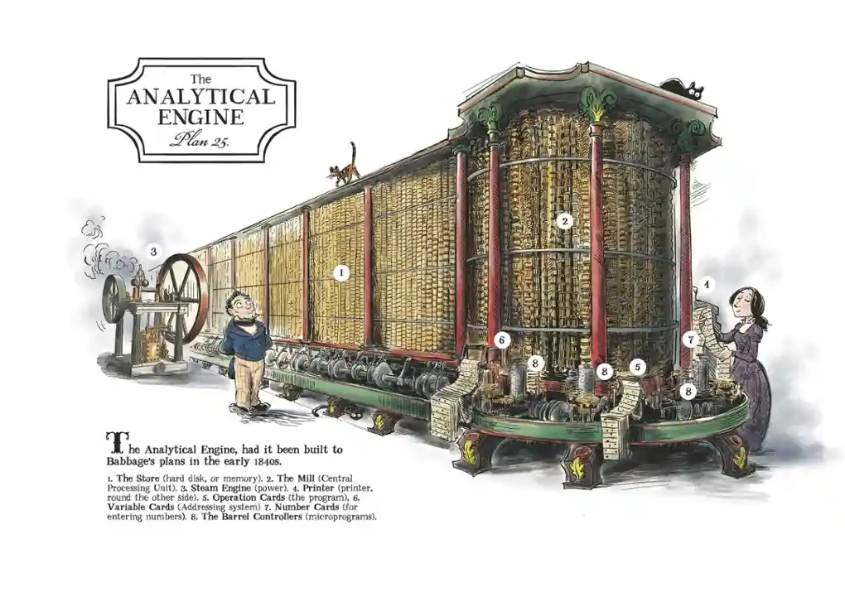
The Analytical Engine
(a computer by any other name)
Estimated to be 3m high, by 7m long, steam powered, and capable of handling 50-digit decimal numbers

Slide 27
The Analytical Engine’s ‘computer’ credentials
A “store” – memory (potentially unlimited data storage)
A ”mill” – central processing unit (CPU)
Programmable, with program storage – “Jacquard loom” punch cards
A Printer (as per Difference Engine no. 2)
A programming instruction set that included:
  Conditional branching (“if-then-else”)
  Control transfer (“go-to”)
  Looping
Capable of any symbolic manipulation
  ‘Turing-complete’, in computer science jargon, a general-purpose computer

Slide 28
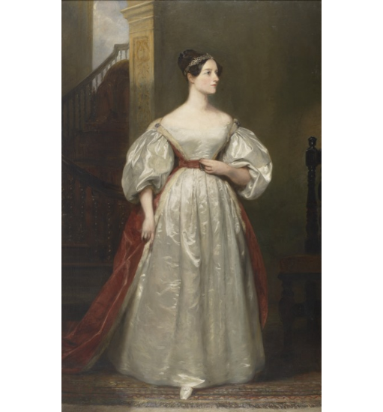
Babbage commenced the design for the Analytical Engine around 1834, but just a year earlier he was introduced to a young debutante and gifted mathematician called Augusta Ada Byron, and her mother, at her “coming out”, both of whom he invited to one of his soirées in London to see the Difference Engine no 1 demonstrator.
This initiated a lifelong friendship between Ada, later Countess Lovelace, and Babbage.
Later, the resurrection of the design for Difference Engine No. 2 and Babbage’s failure to secure funding to build it, put paid to any hope of the Analytical Engine making it off the drawing board, not that it could have been built with 19th century technology anyway.

Slide 29
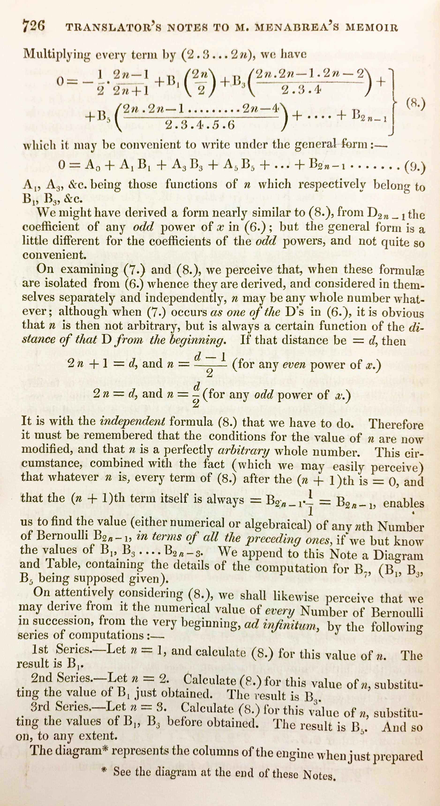
Instead of publishing any details, for fear of criticism, Babbage instead presented the design in a series of lectures in Turin.
An attendee, Luigi Menabrea, published a paper based on the lectures, which was then translated into English by Ada.
But she added extensive notes of her own. The last of seven notes (right) set out the method for the Analytical Engine that would compute the sequence of Bernoulli numbers*.
This was not a design for machinery, or hardware as we might call it today, but an algorithm, or software. This was the world’s first software program, and consequently Ada Lovelace is now celebrated as the world’s first computer programmer.
* Extremely important in number theory and numerical analysis

Slide 30
But, alas, it has not always been so.
Babbage’s work, and Ada’s contributions, historic though they were, were largely forgotten about until the 1950’s, when Alan Turing, the ”father” of modern electronic computers, and others rediscovered Ada’s work and recognised it for what it is. Nowadays both Charles and Ada are celebrated for their respective achievements.
Babbage had envisaged and designed a machine that was way ahead of its time – waiting for electricity, electronics and the transistor to come along to make it viable. Its modern electronic counterpart, however, was invented in ignorance of his work on mechanical computation. Is Babbage really the inventor of the modern computer?
But the modern world depends on software, and it took the genius and foresight of Ada Lovelace to recognize it and crystalise it for the first time in human history.

Slide 31
She speculated that the Engine “might act upon other things besides number… the Engine might compose elaborate and scientific pieces of music of any degree of complexity or extent.” The idea of a machine that could manipulate symbols in accordance with rules and that number could represent entities other than quantity mark the fundamental transition from calculation to computation. Ada was the first to explicitly articulate this notion and in this she appears to have seen further than Babbage. She has been referred to as “prophet of the computer age.” Certainly she was the first to express the potential for computers outside mathematics.
“ADA LOVELACE” AT THE COMPUTER HISTORY MUSEUM
“The Analytical Engine has no pretensions whatever to originate anything. It can do whatever we know how to order it to perform.”
Ada Lovelace to Charles Babbage

Slide 32
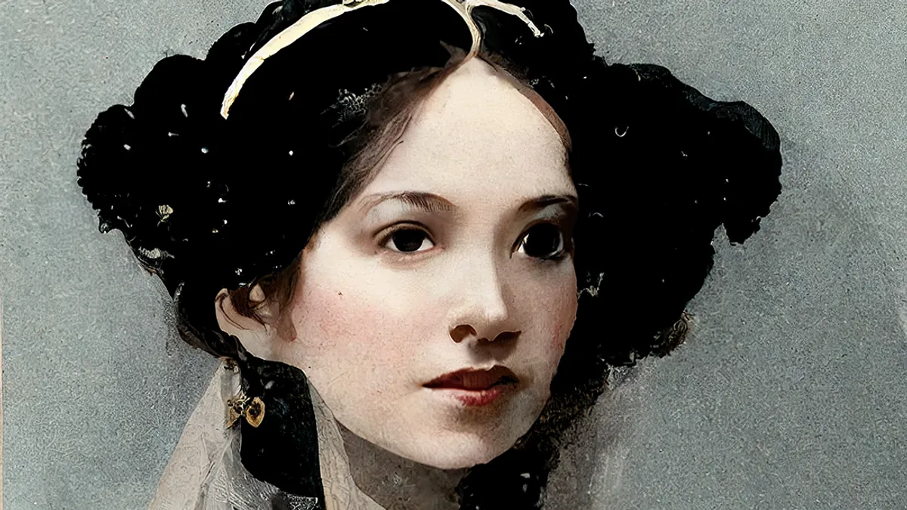
“Note B has plagued me to death; altho’ I have made but little alteration in it. Such alterations as there are however, happen to have been very tiresome & to have demanded minute consideration & very nice adjustments.
It is a very excellent Note.
I wish you were as accurate, & as much to be relied on, as I am myself.
You might often save me much trouble, if you were; whereas you in reality add to my trouble not infrequently; and there is at any rate always anxiety of doubting if you will not get me into a scrape; even when you don’t.
By the way, I hope you do not take it upon yourself to alter any of my corrections.
I must beg you not. They all have some very sufficient reason. And you have made a pretty mess & confusion in one or two places (which I will show you sometime), where you have ventured in my [manuscripts] to insert or alter a phrase or word; & have utterly muddled the sense.”
Extract of a letter from Ada to Charles, 1st August 1843

Slide 33
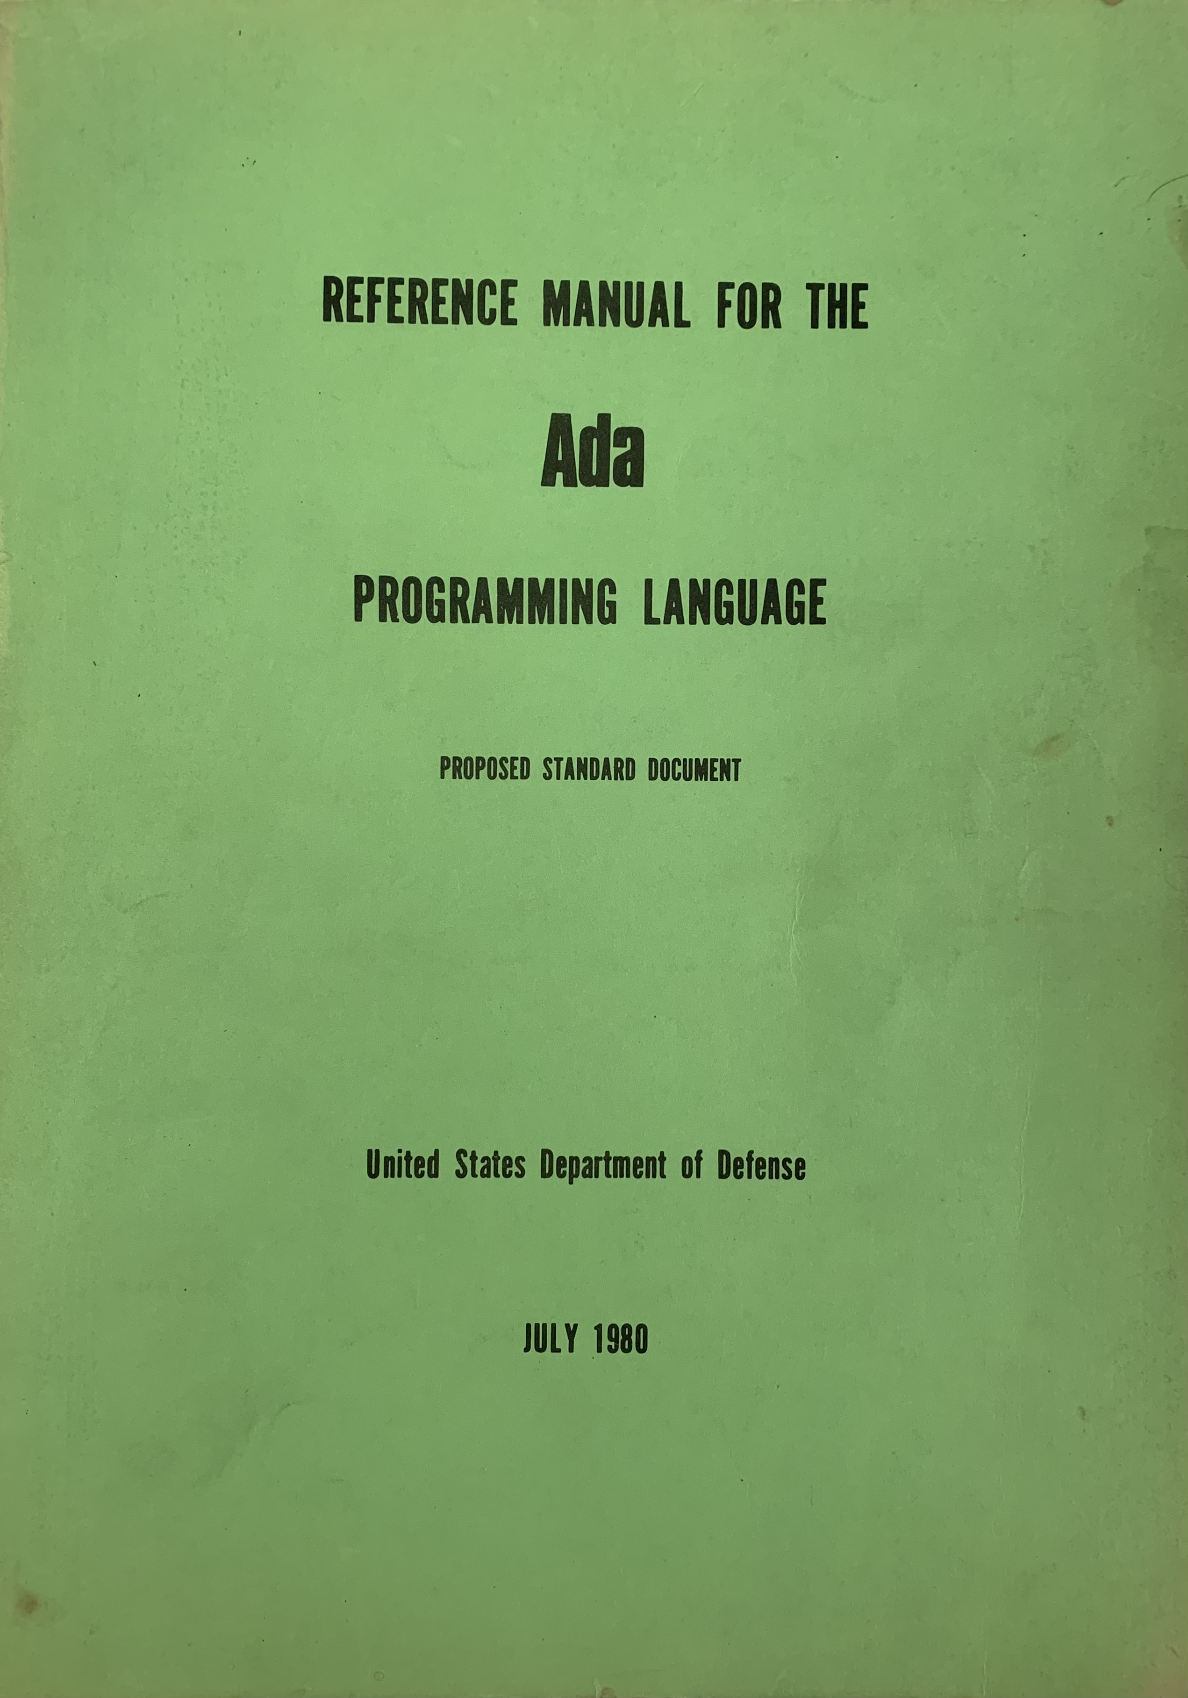
Ada’s Legacy
In the late 1970s the US Department of Defense held a competition to define a single new programming language for all DoD systems.
The four competitors were code-named Red, Blue, Green and Yellow to hide their affiliations from the DoD adjudicators. Green was the only European (mainly UK and French) entrant.
The winner was anointed ‘The Ada Programming Language’ in honour of Countess Lovelace.
Guess which language won? ☺

Slide 34
Thank you!
&
Questions?

